Slide 1
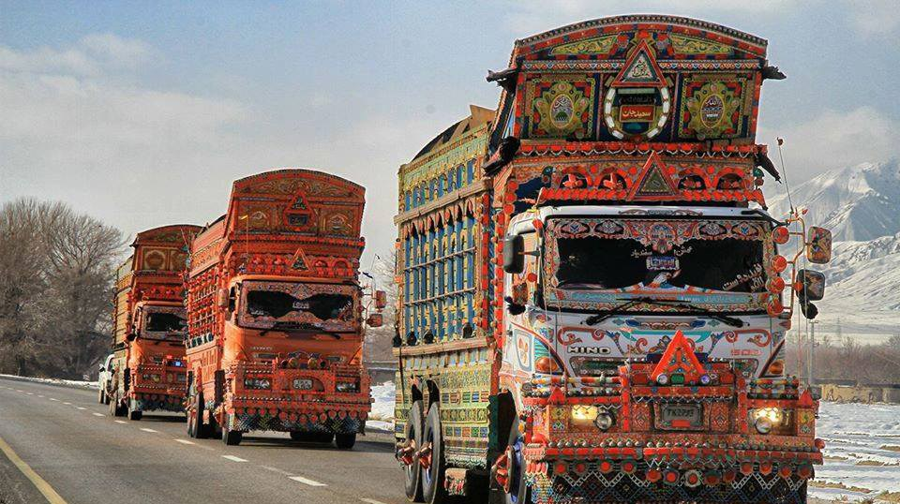



NTRC Study on Freight Transport
(Trucking) in Pakistan
ZEERUK
INTERNATIONAL PVT. LTD.

Slide 2


SEQUENCE OF THE PRESENTATION
Overview of Transport Sector in Pakistan
Objectives & Approach for the Study
Fleet Characteristics
Road Freight Transport Prices & Costs
Contemporary Challenges for Local Trucking Industry
Modern Trucking Concepts
Recommendations

Slide 3
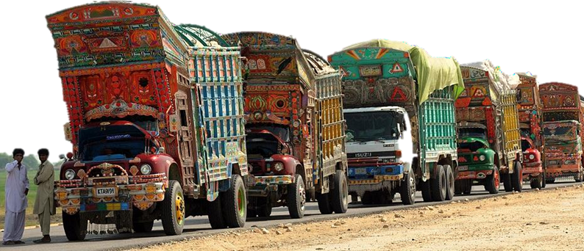
INTRODUCTION
Transport – Driver of Socioeconomic development
Efficient and well-maintained transportation system – Backbone
Transport sub-sectors: Road, Rail, Air, Maritime, Inland waterway and Pipeline
The World Bank Logistic Performance Index (LPI) of Pakistan (2018) - 122 out of 160 countries
Bangladesh and India are far ahead than Pakistan

Slide 4
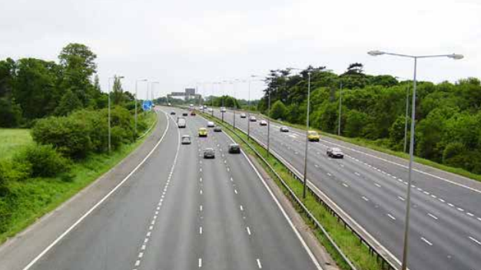
Overview of
Transport Sector
in Pakistan
Transport sector contributes 13% to the GDP and accounts for 5.4% of the nation’s total employment
Fragmentation of the Transport Sector – Various ministries; lack of coordination
Unbalanced development – Railway Network, 2% Freight Market Share and 5% of the passenger market
Road is dominant mode in Pakistan – carries 96% of freight traffic
Lack of a coherent institutional framework
Out-dated Legislations - Motor Vehicles Ordinance 1965, National Highway and Safety Ordinance 2000
Poor hinterland connectivity – causes long delays
Karachi Port handles 60% of all of Pakistan’s seaborne traffic

Slide 5
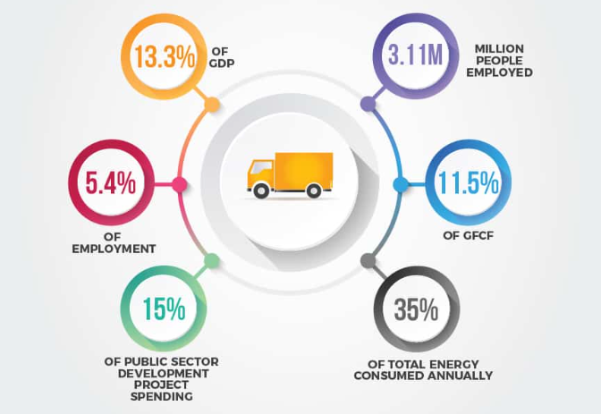
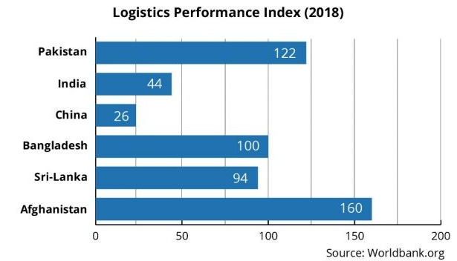
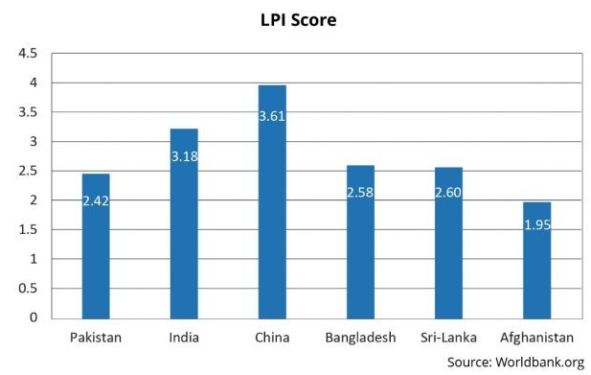
Overview of Transport Sector in Pakistan (cont.)

Slide 6
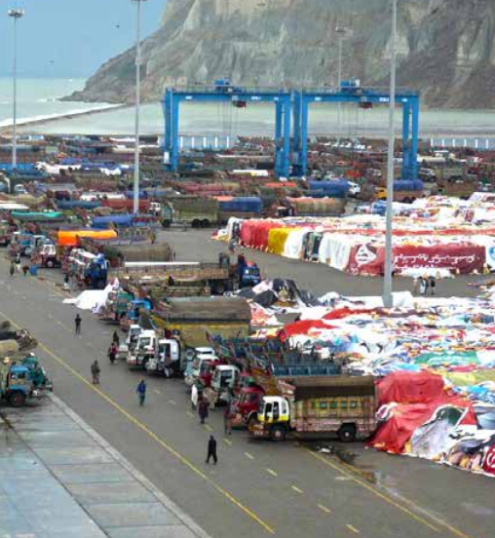
Overview of Transport Sector in Pakistan (cont.)
National Transport Policy – approved in November 2018 by Federal Cabinet
Attempt to create a safe, efficient, and sustainable transport system to realize Pakistan’s Vision 2025
Modernizing Transportation Infrastructure & Greater Regional Connectivity – Pillar VII of Pakistan’s Vision 2025
“National Freight and Logistics Policy (NFLP)” - recently approved by ECC in principle for implementation

Slide 7

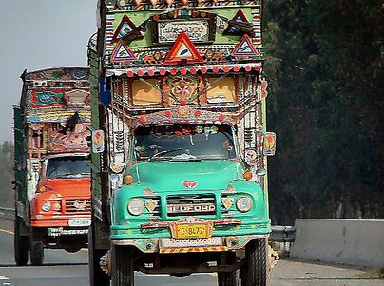
TRUCKING INDUSTRY IN PAKISTAN
Fragmented Nature - privately-owned companies and individual owners & operators
Free Market - “Hire & Reward System”
Un-organized, informal and low barriers
High Competition & Low Profits
Trucking companies - Price takers in the market rather than price givers
Overloading to maximize profits
Local Modifications and Alterations
A “Trucking Policy” in 2009 - to recognize trucking sector as an industry – Never Implemented.

Slide 8
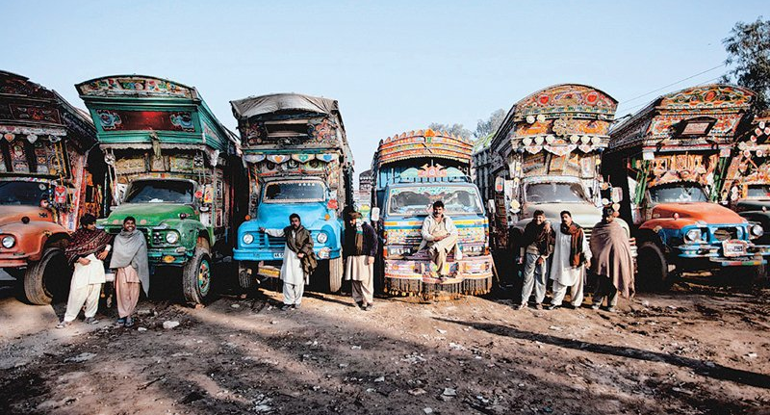
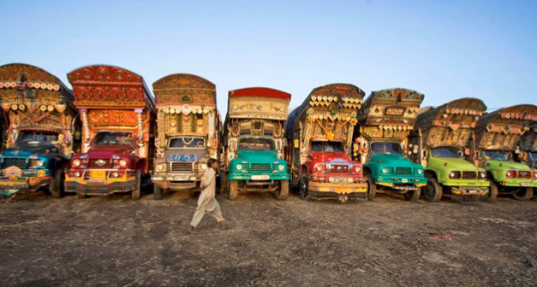
EXISITING PRACTICES IN TRUCKING SECTOR OF PAKISTAN
Old and obsolete technology - most of the trucks used in freight transport are more than 30-35 years old.

Slide 9
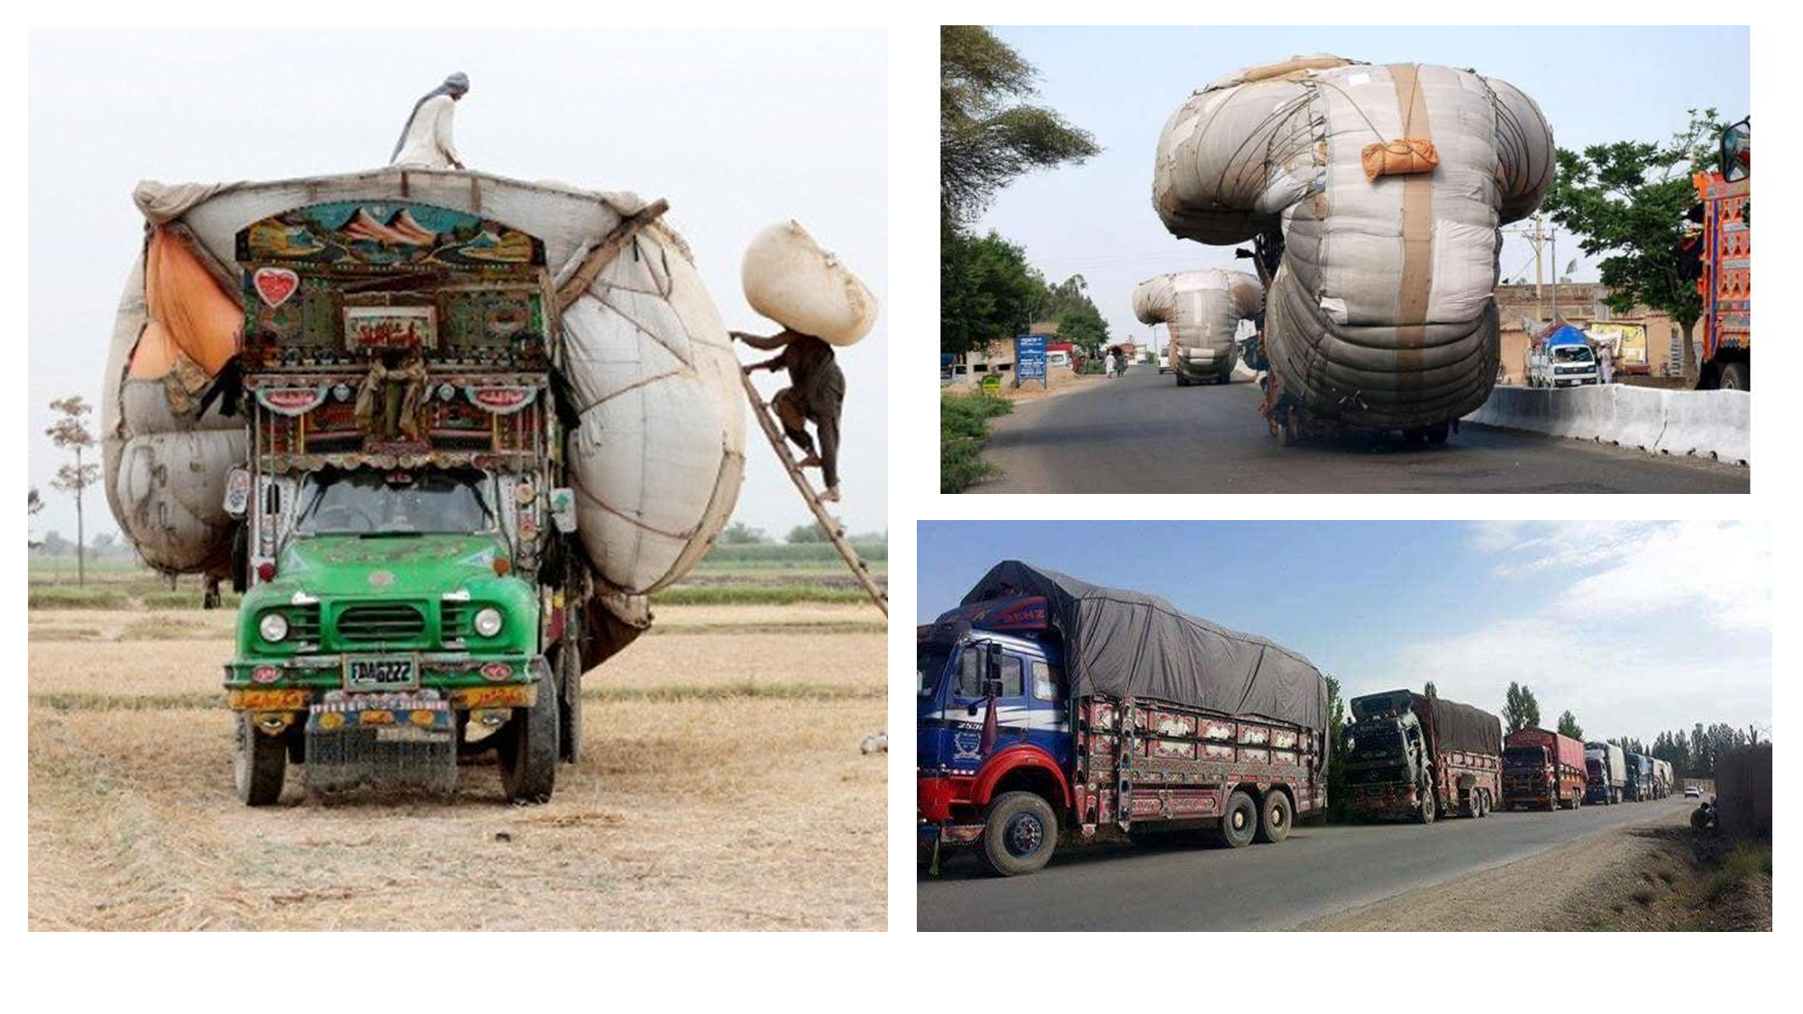
EXISITING PRACTICES IN TRUCKING SECTOR OF PAKISTAN (cont.)
According to an estimate, about 30% of the rigid trucks are loaded while 40% of articulated (4,5 and 6 axle) trucks are overloaded.

Slide 10
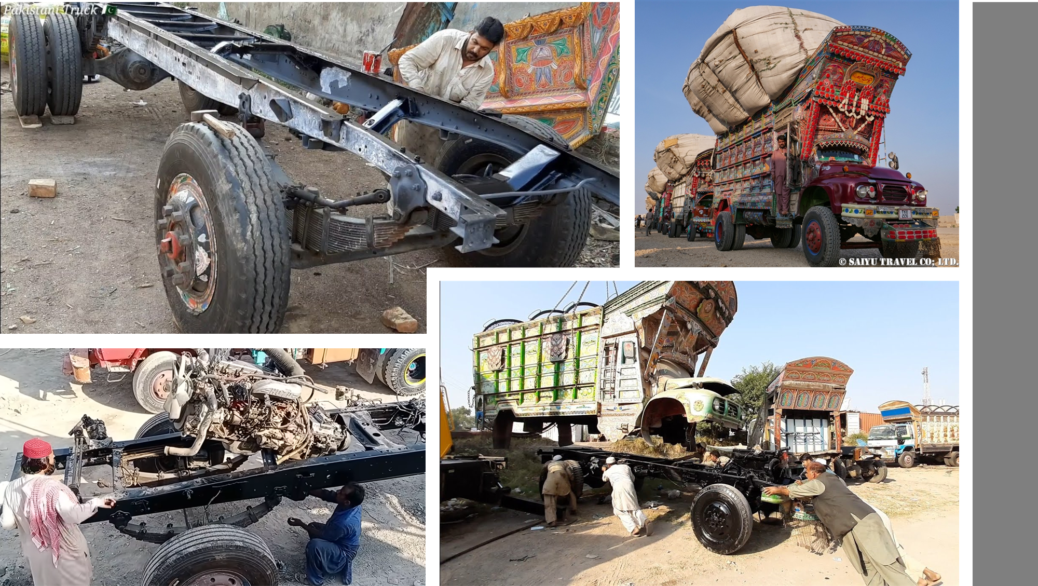
EXISITING PRACTICES IN TRUCKING SECTOR OF PAKISTAN (cont.)
Modifications and strengthening in local workshops to carry heavier loads.

Slide 11
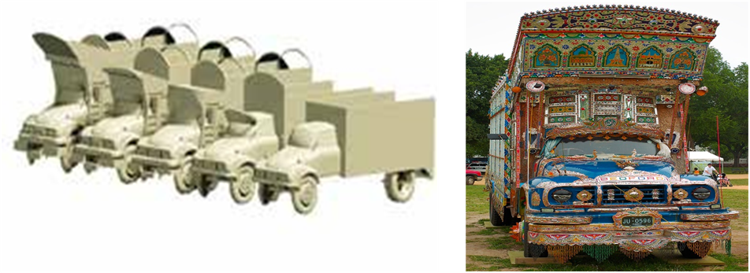
EXISITING PRACTICES IN TRUCKING SECTOR OF PAKISTAN (cont.)
The retrofitting of old rail bogey axles into truck/trailer axles is also a common practice, which is a cause of many road accidents.

Slide 12
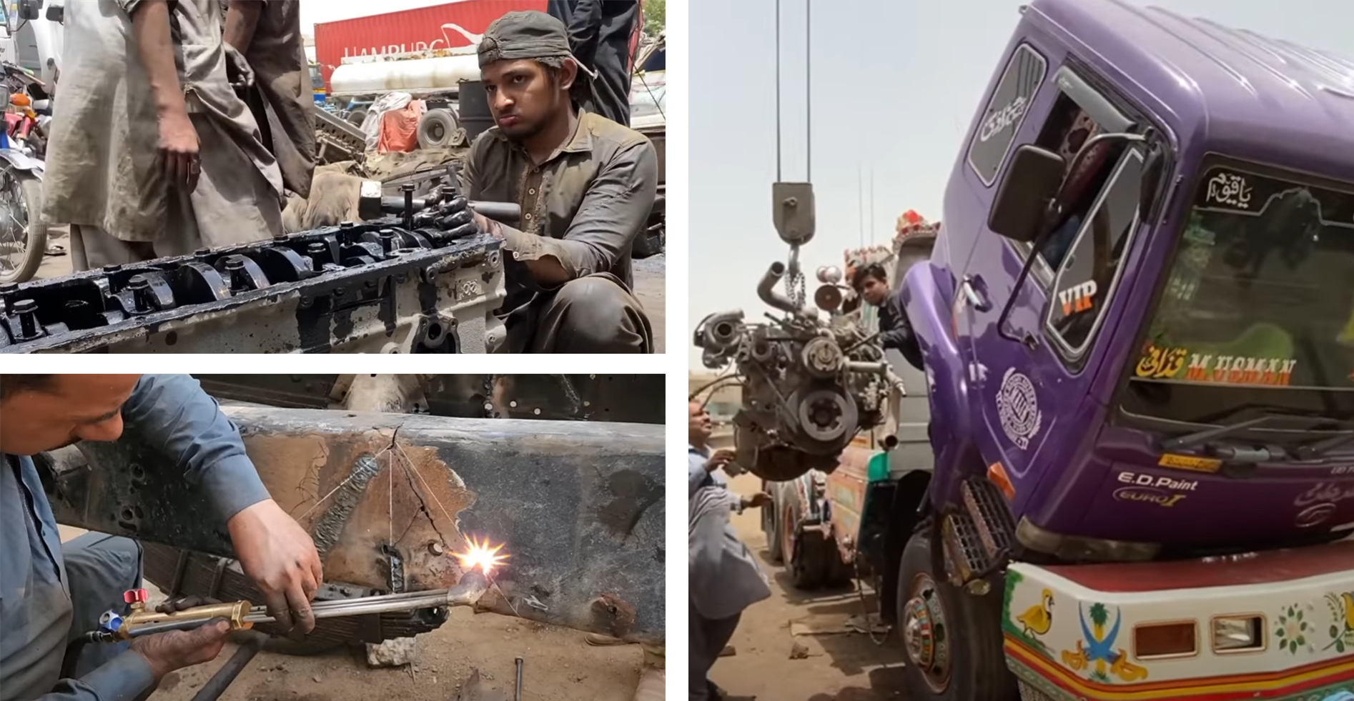
EXISITING PRACTICES IN TRUCKING SECTOR OF PAKISTAN (cont.)
Improper maintenance and fitness certifications

Slide 13
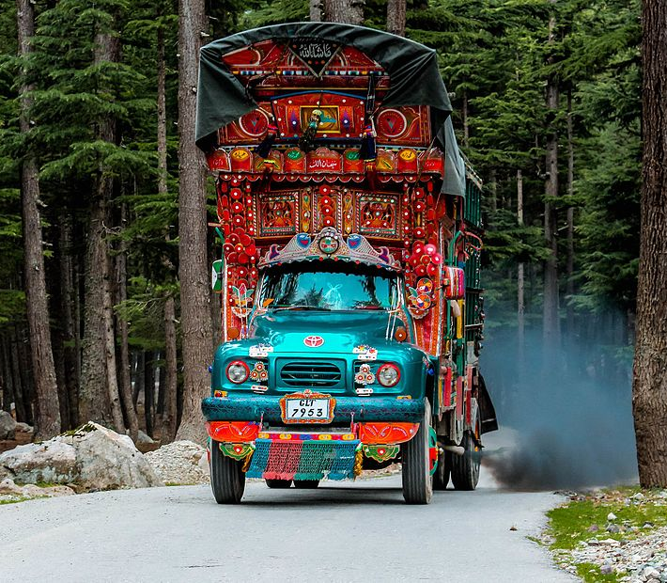
EXISITING PRACTICES IN TRUCKING SECTOR OF PAKISTAN (cont.)
High emissions due to old engine technology

Slide 14
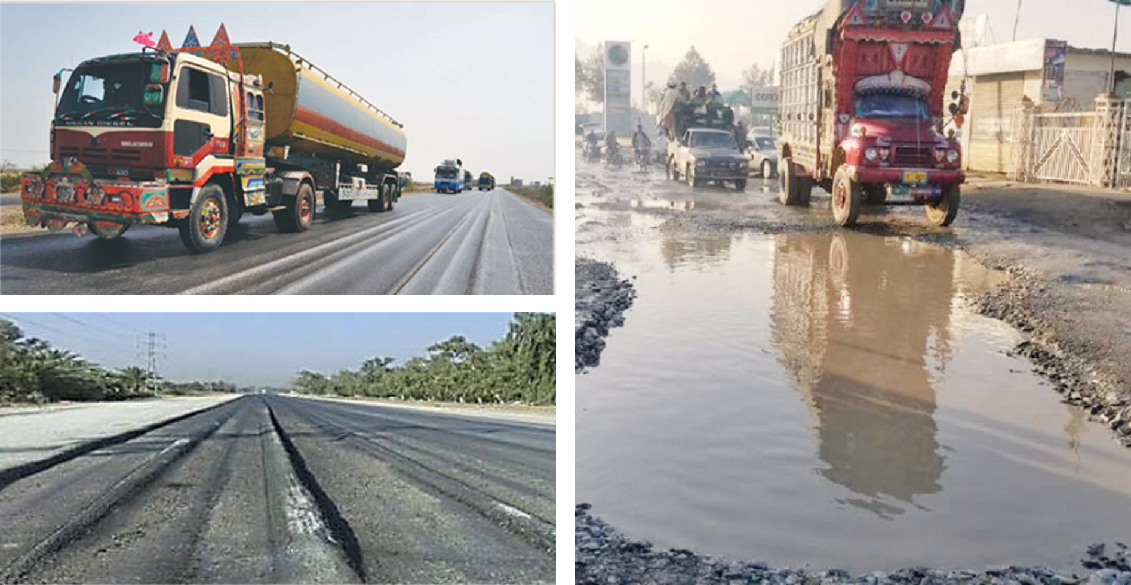
EXISITING PRACTICES IN TRUCKING SECTOR OF PAKISTAN (cont.)
Road deterioration due to higher axle loads – Huge infrastructure maintenance costs, higher travel times and fuel costs

Slide 15
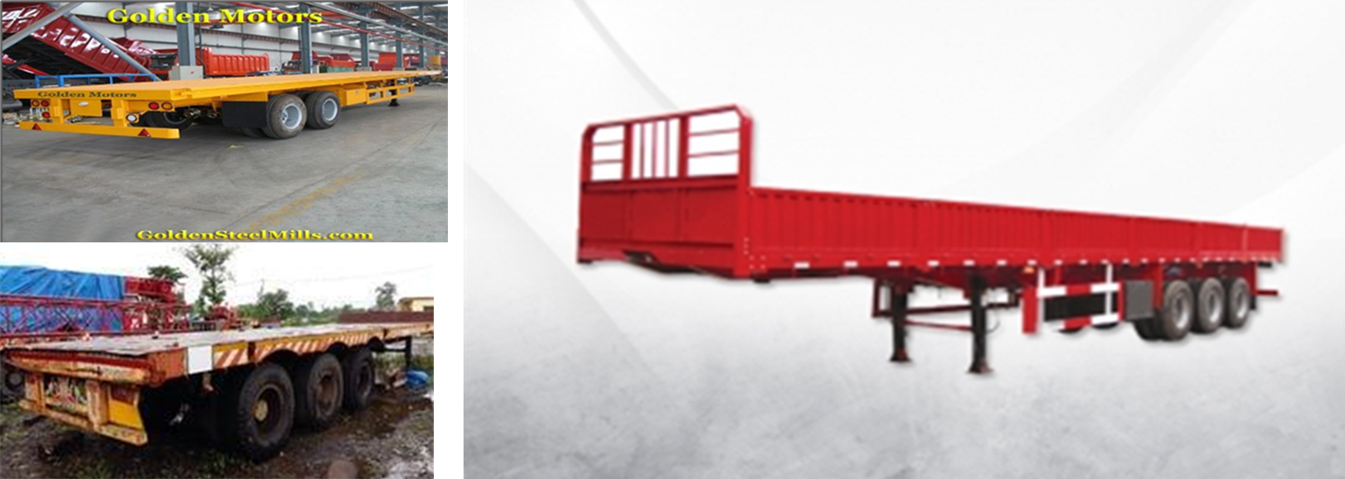
EXISITING PRACTICES IN TRUCKING SECTOR OF PAKISTAN (cont.)
Use of mechanical and rigid suspensions instead of Pneumatic suspensions – increases vibrations and structural fatigue and component replacement and reduces life of tires

Slide 16
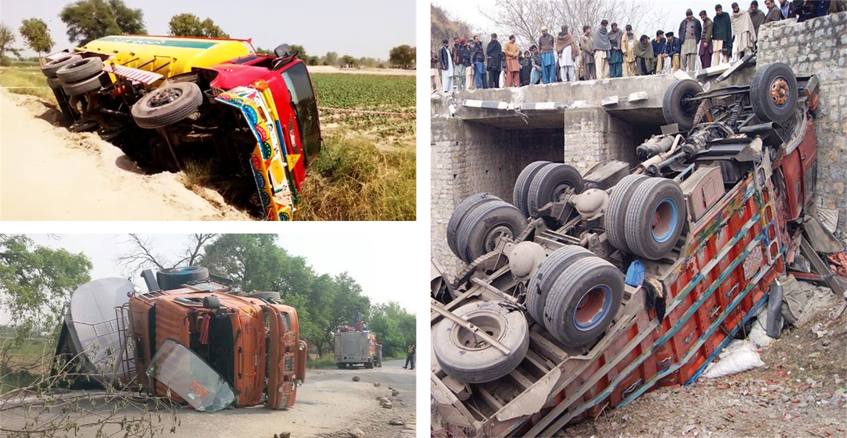
EXISITING PRACTICES IN TRUCKING SECTOR OF PAKISTAN (cont.)
Increased accident likelihood - Modifications in truck dimensions results in poor aerodynamics causing road accidents.

Slide 17
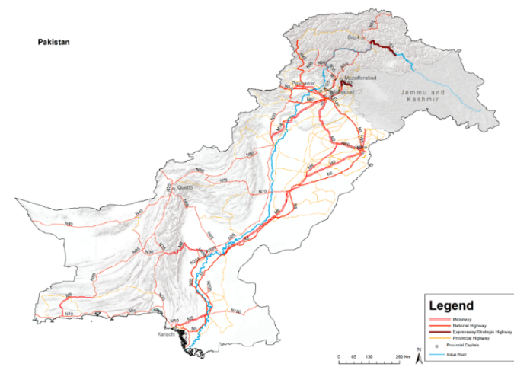
Road infrastructure & freight transport
Four levels of road transport flows - International Transport (Cross Border Points), Inter-city via the strategic federal and provincial network, and intra city urban and rural transport
Freight & Urban transport - dominated by the road sector
Pakistan’s current road network - more than 500,000 km
Road density of 0.63 km/km² - (NTRC study)
National highways and motorways network (12,000 km) – Merely 2.4% of the total road network
Roads - accounts for 94% of all passenger kilometers (pkm) and 95% of freight ton kilometers (tkm)

Slide 18
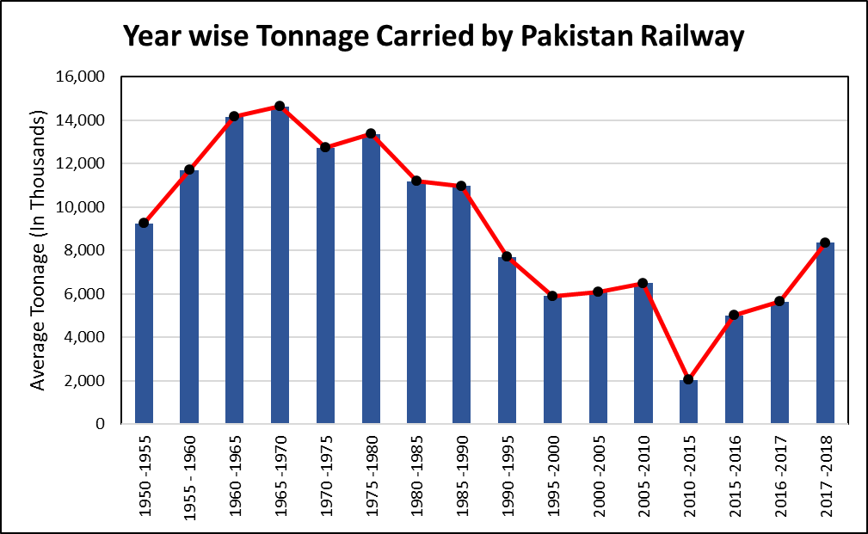
Road infrastructure & freight transport (cont.)
Existing freight demand of the country -195 billion ton-kms (National Transport Plan 2020)
95% of Freight (185.25 billion ton-kms) - moved through roads in trucks of different types
Pakistan Railways (PR) in the freight haulage – Decline
In 1950s, PR’s share in freight haulage was over 86% - now 4% only (PBS, 2008)
Major factor - the cross-subsidization of passenger traffic from freight
According to the Planning Commission (Government of Pakistan, 2011),
Productivity of PR’s freight operations was only one-eighth and one-third of China and India, respectively (Planning Commission, 2011)

Slide 19
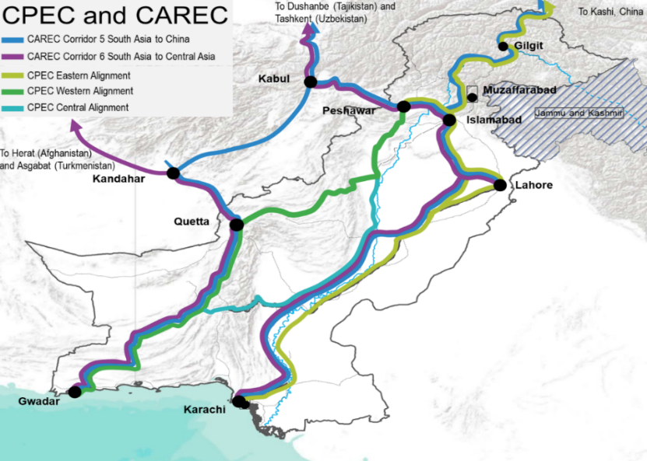
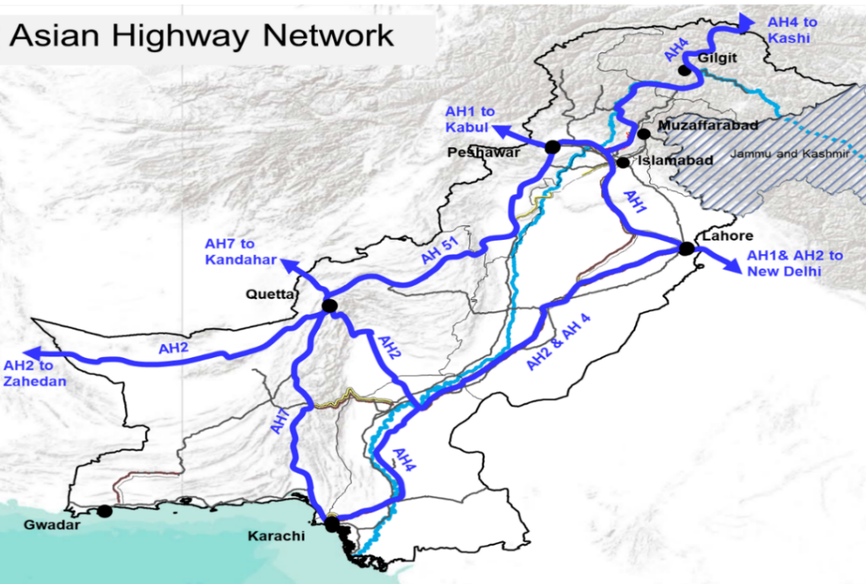
International Context for Regional Transport
Several key corridors defined by ECO, CAREC, the UNESCAP, & the CPEC
Potential for regional travel along these key routes, and form part of the national corridor definition

Slide 20
stakeholders
Sector | Stakeholders
Ports | Port Authorities at Karachi, Gwadar, and Qasim Ports
 | Pakistan Customs
 | International and local terminal operators
 | Federal Board of Revenue
 | Karachi Dock Labour Board (working at Karachi Port) and other employee associations in the port
 | Private-sector stevedoring companies
 | Logistics and Freight forwarding companies as well as cleaning agents
 | Exporters and importers, in addition to the business community in general
 | Fishing communities
Highways and Trucking | National Highway Authority & Provincial C&W Departments
 | Owners and employees of trucking companies (many are sole proprietorships)
 | Owners and employees of auxiliary services
 | Families and communities where the road transport sector is a major employer
 | Logistics and freight forwarding companies as well as clearing agents
 | Trucking manufacturing industry
 | Pakistan Standards and Quality Control Authority (PS&QC)
Railways | Pakistan Railways
 | Railways Workers Union
 | Dry Ports
 | Logistics and freight forwarding companies as well as clearing agents
 | Exporters and importers, in addition to the business community in general
Aviation | Civil Aviation Authority
 | Pakistan International Airlines
 | Management of at least one private airline
Traders | Exporters and Importers, in addition to the business community in general
 | Chambers of Commerce & Industry
Cross-cutting | Communities living along the main trade corridor
 | Families of those employed in the trade and transport sector (including women and children)

Slide 21
    Matrix for involved actors in Transport Sector
Involved actors | Roles | Goals and Interests | Example
Planning Agencies | National Communications policy making, planning, research development, maintenance of communication services and road infrastructure | Socio-economic development | Ministry of Communication
Local Authorities | Regulation and controlling traffic Providing advice and guidance to the Government in taking policy decisions | Regulation and Enforcement of policies | NHMP, NTRC
Transport Associations | Provide structure to transport operations To act as an organ of communication for and to represent the members of the Association in all or any of their relationships with any Government | Strengthen trade and transport logistics Improvement of Trucking Industry | Fleet Operators Association of Pakistan (FOAP), All Pakistan Goods Transport Association
Transport operator | Long distance transport hauling | Less operational costs, less milage, less delays, Empty run reductions etc. | Local transports
Freight forwarder | Managing the freight transport service | More efficient delivery chain
3rd Party Logistics provider (3PL) | Provides outsourced logistics services | Business opportunities, new customers | TCS, Leopards Courier
Citizens | Consumers | Better service

Slide 22
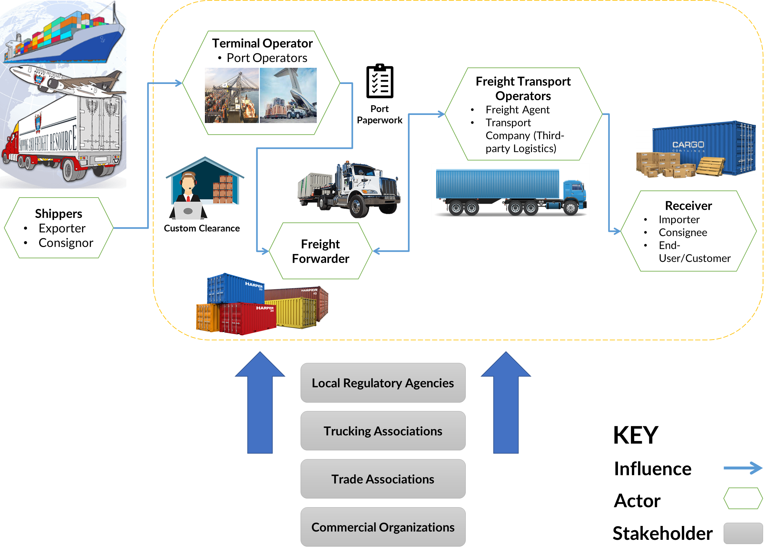
    ACTORS AND STAKEHOLDERS INVOLVED

Slide 23
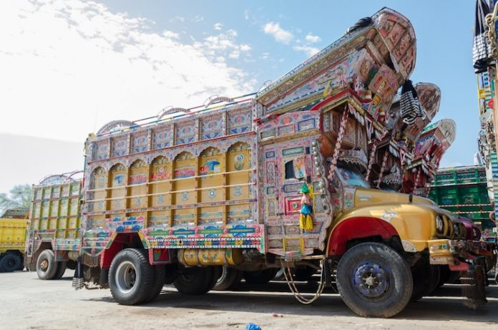
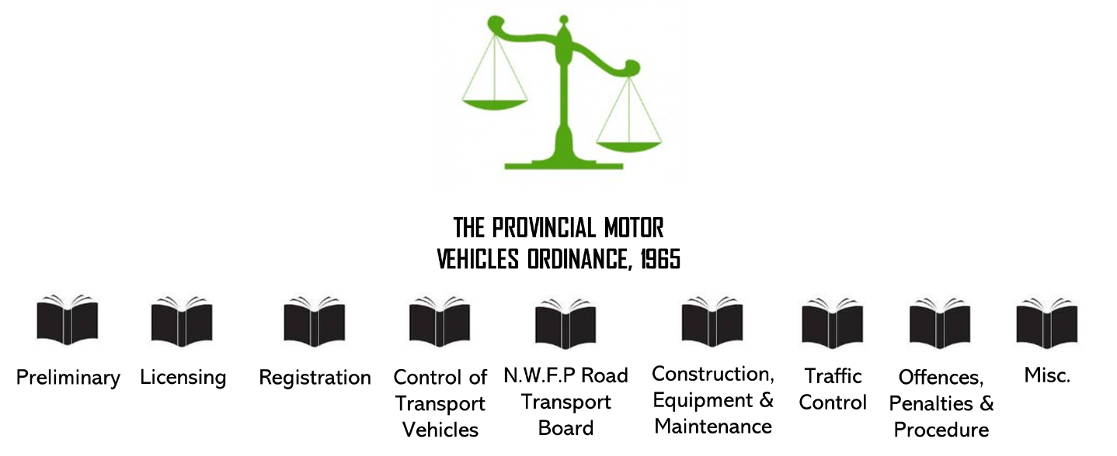
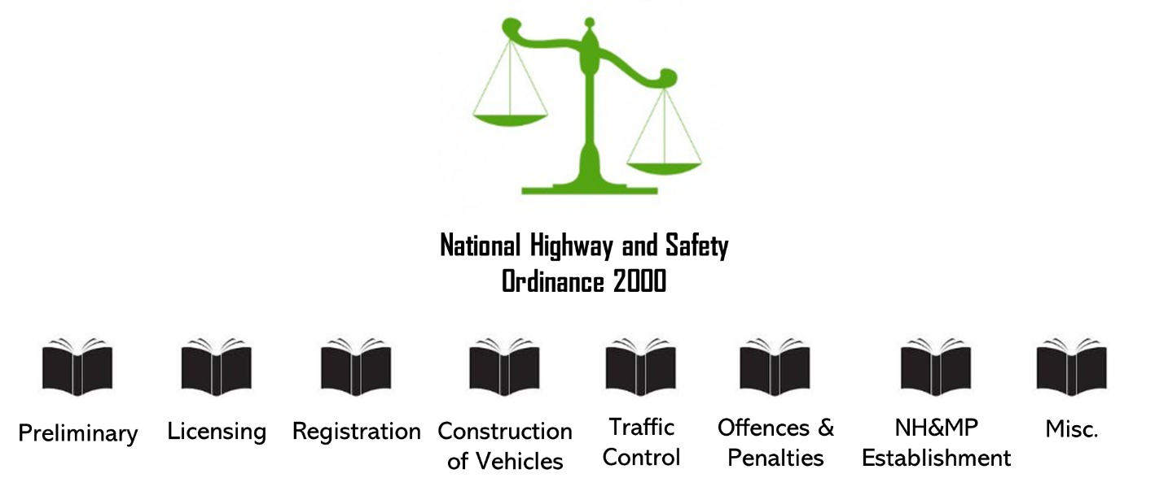
Legal & Regulatory Framework in Pakistan
NHMP
Regulation
NHA
Infrastructure
PILER
Truck driver’s related matters
EDB
Trucking specifications
NTRC
Policy and Research

Slide 24
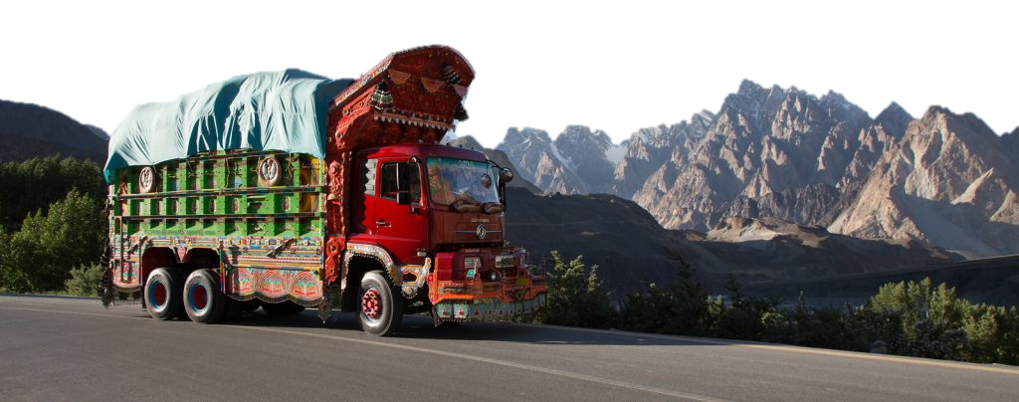
Objectives of the Study
Determination of Truck Fleet Population in Pakistan
Analysis of Transport Prices & Costs of Trucks
Pakistan’s Trucking Industry Comparison with International standards
Fleet Operational & Financial Characteristics

Slide 25

Objectives of the Study (cont.)
Freight External Costs
PKR/ton-km
Rigid & Articulated Trucks
VOC Model for Trucks
Regional Comparison
Registered Vehicles
Gaps in data (registered and on-road & owners' data)
Age Structure
Fleet Age (KPI – Policy Point of view)
IT Adaptation by Industry
Barriers and Benefits

Slide 26
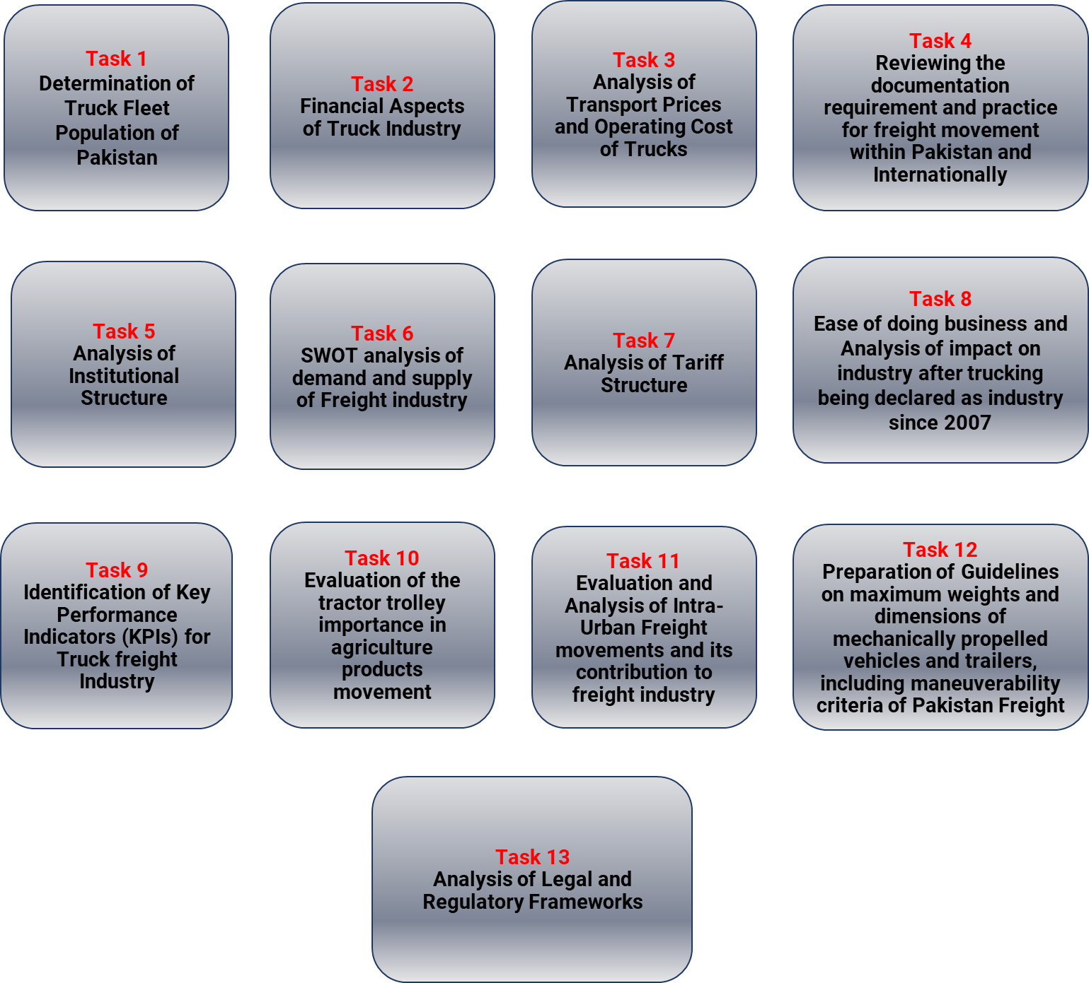

APPROACH FOR the Study

Slide 27




APPROACH FOR the Study (cont.)
Step 2
Step 4
Background Research and Development of Survey forms
Results / Outputs
  Ports
    (3 major Sea ports + Dry)
  Borders
  Industries (Fertilizer, Cement, Steel, Textile)
  Roadside Interview surveys
  Truck Owners’ survey
  Operators Survey
  Survey from Industries
  13 Districts
  Major Trucking Routes
  N-5
  N-55, Indus Highway
  Fleet population
  Financial Aspects
  Institutional Structure
  KPIs
  IT Adaptation
Identify Cargo Origin / Loading Sources & Major Stakeholders
Conducting the Survey
Step 1
Step 3

Slide 28
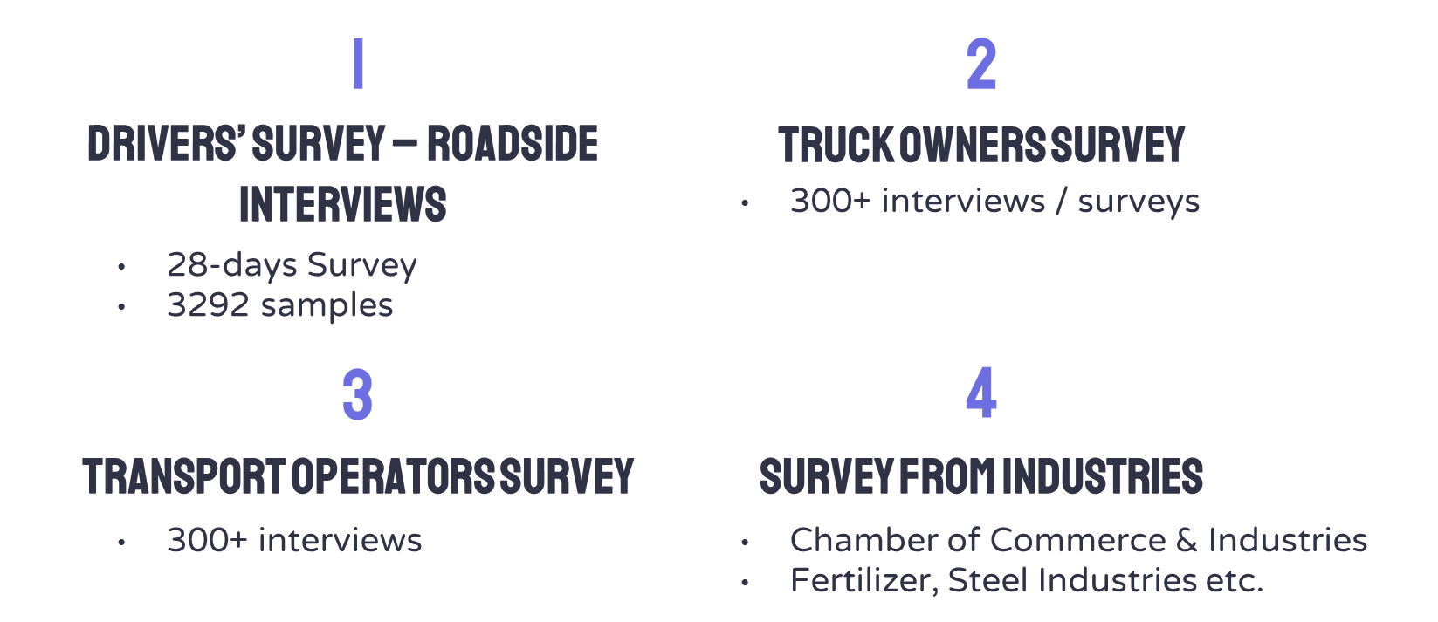
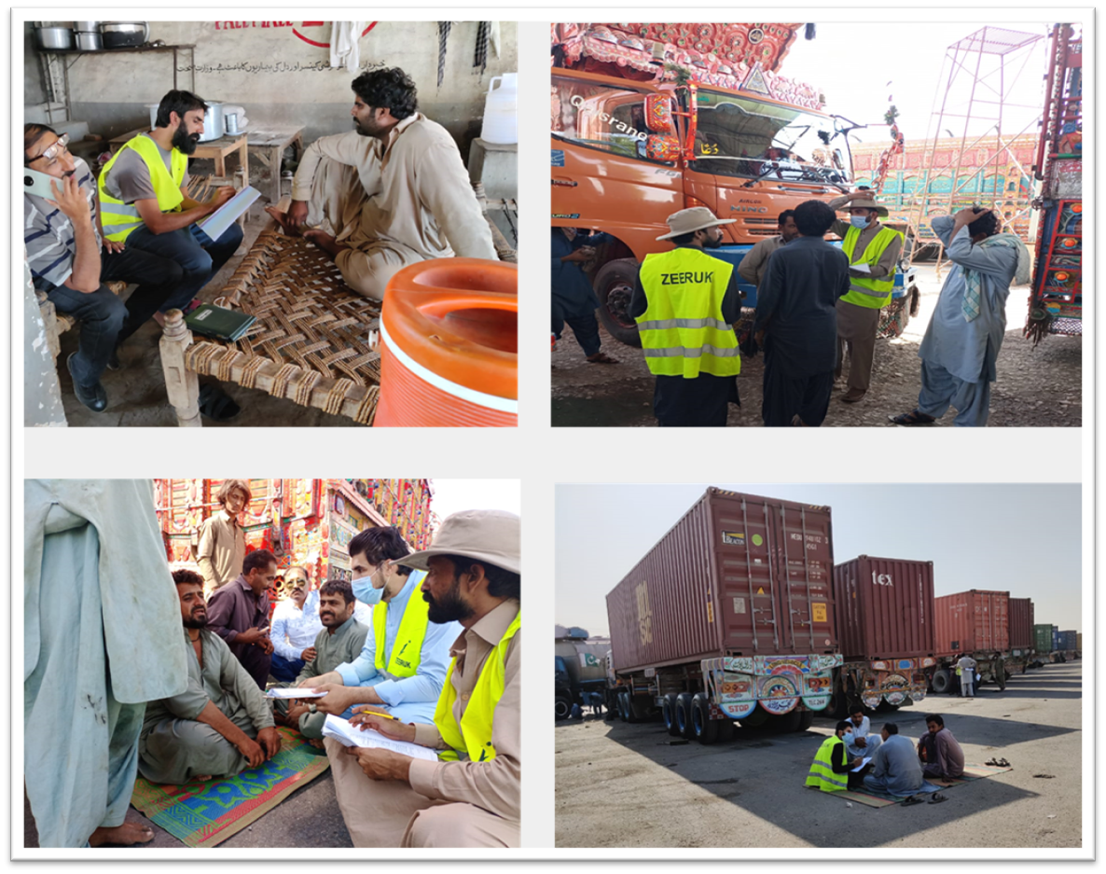
Surveys – Core of the Study

Slide 29
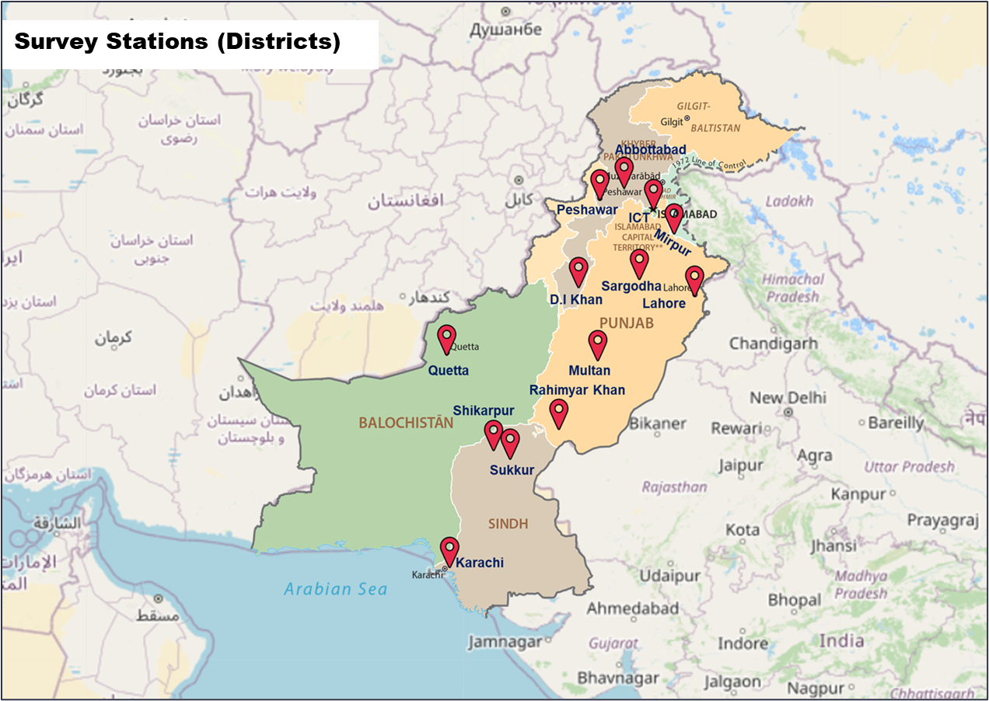
Surveys STATIONS
Sr. No. | District | No. of Samples Collected
1. | Abbottabad | 109
2. | Mirpur | 07
3. | Peshawar | 122
4. | Mardan | 121
5. | Sargodha | 278
6. | Lahore | 274
7. | Multan | 281
8. | Rahim Yar Khan | 302
9. | Sukkur | 251
10. | Shikarpur | 27
11. | Karachi | 1,000
12. | Quetta | 267
13. | Dera Ismail Khan | 243
 | TOTAL | 3,282

Slide 30
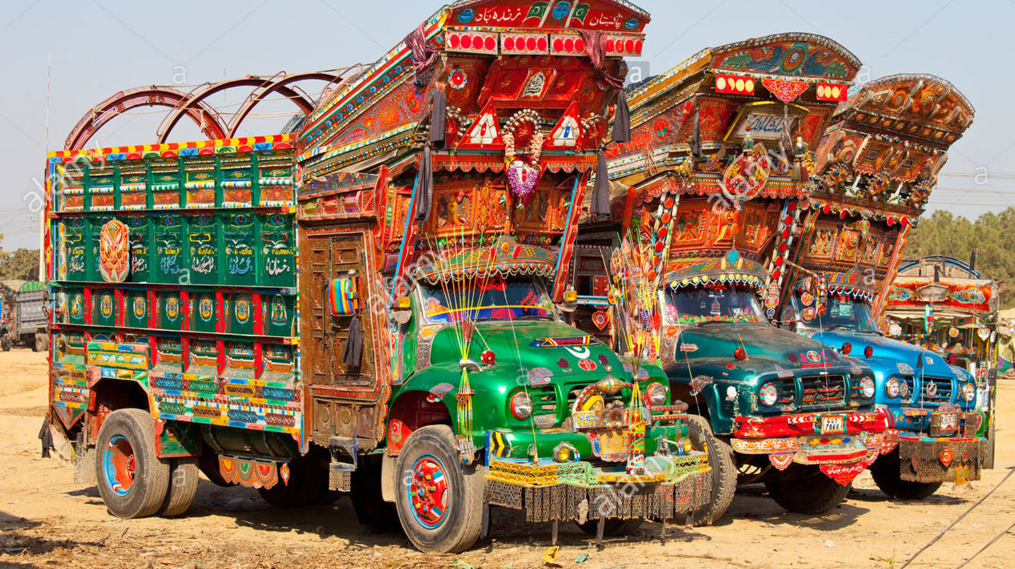
FLEET population

Slide 31
Truck Fleet Size
Fleet Composition
Fleet Characteristics
By Import and Assembly
Ownership Type
Registered Number of Trucks
By Model, Make
Acquisition Mode
No. of Axles
Average Annual Milage etc.
Surveys’ Data
E&TDs
PAMA

Slide 32
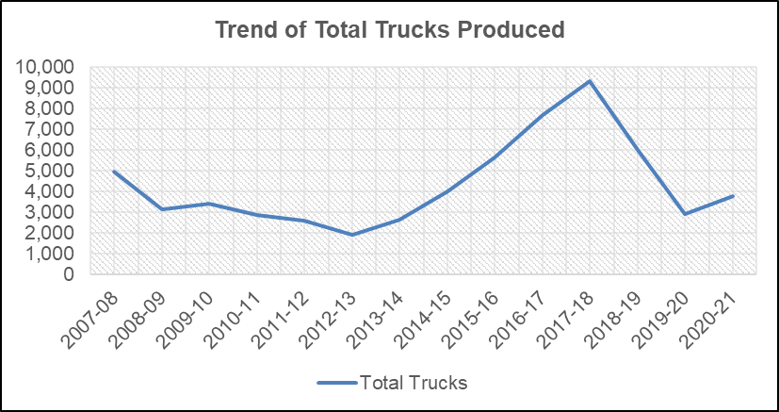
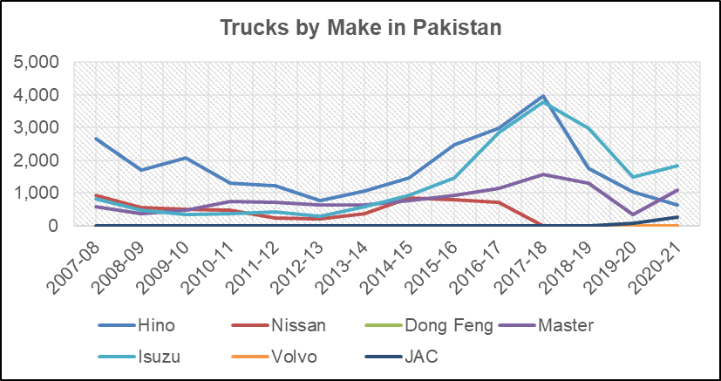
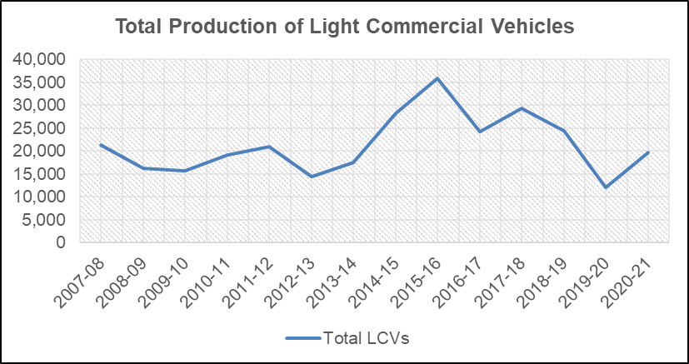
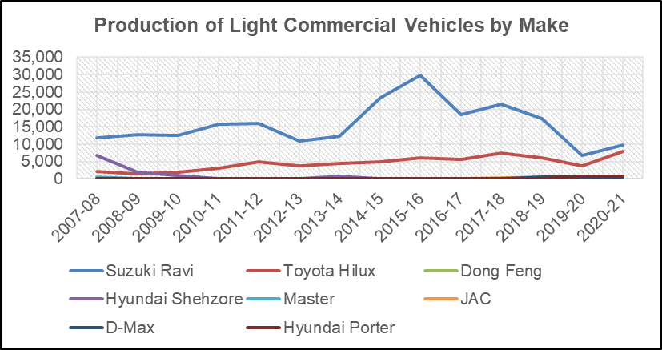
Goods Vehicles Manufacturing in Pakistan
Total = 88,952
Total = 401,716
Source: PAMA

Slide 33
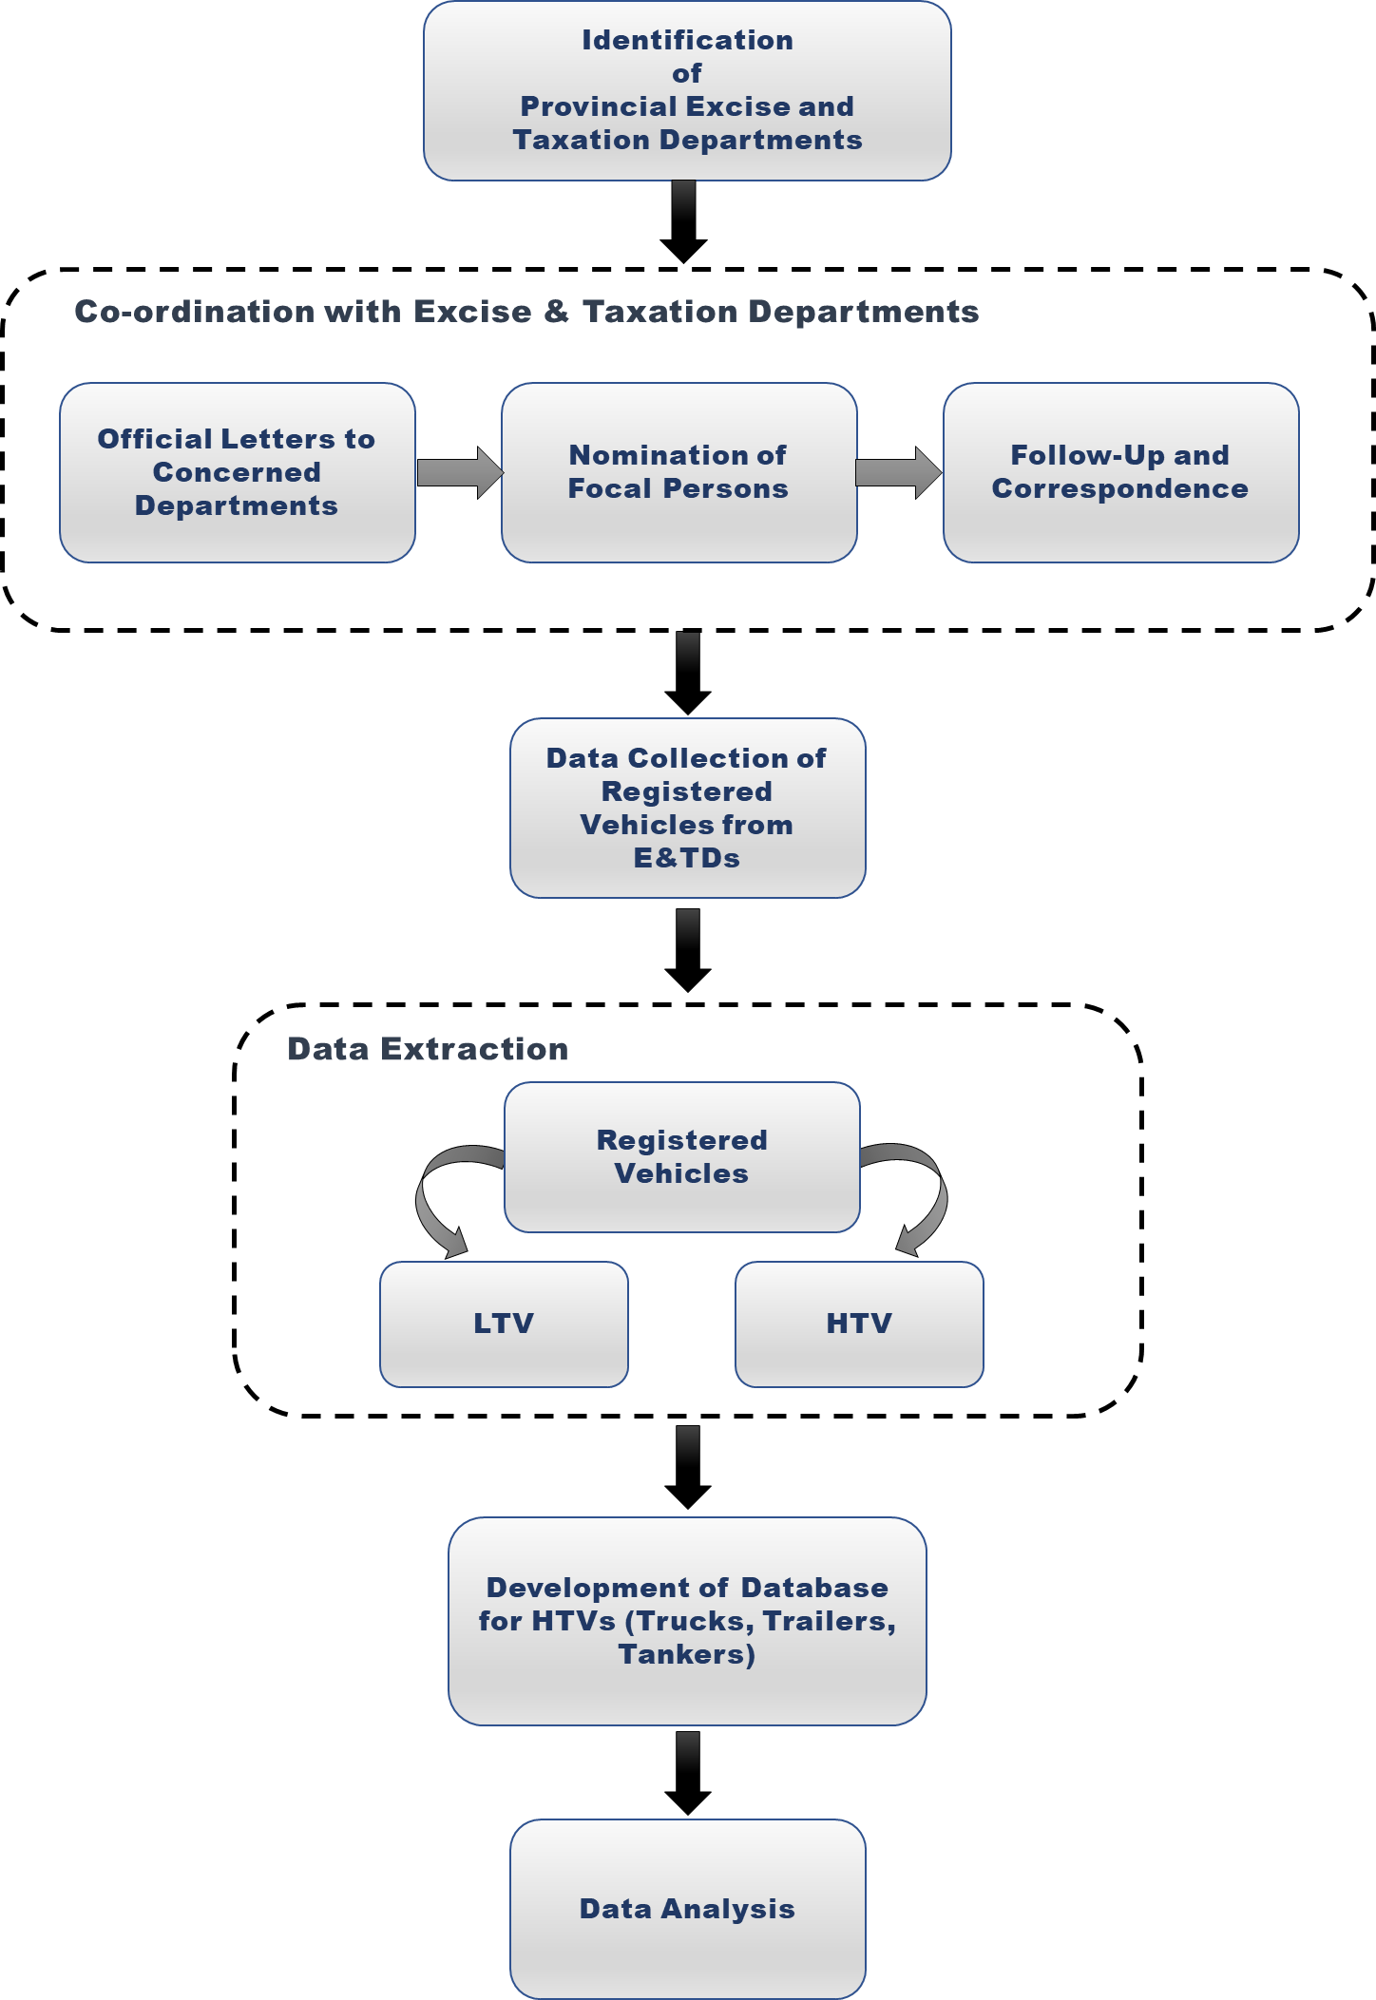
Data Collection from Excise and Taxation Departments
Province | Focal Person | Designation
Balochistan | Mehmood Khan | Senior Database Administrator
KPK | Tahir Khan | Database Manager
Punjab | Muhammad Saleem | Database Administrator
Sindh | Mehran Khan | Deputy Director - System Analyst
Islamabad (ICT) | Zeeshan Ali | Database Manager
Azad Jammu & Kashmir (AJ&K) | Faiz Ullah | Deputy Director (MIS), Mirpur Division
 | Asad Ullah | Deputy Director (MIS), Muzaffarabad and Poonch Division
Gilgit Baltistan | Abubakar | Deputy Director

Slide 34
Record of Registered heavy Vehicles in Pakistan
Description | Bed Ford | Hino | Isuzu | Mercedes-Benz | Nissan | Others | Total
Mini Trucks | 142 | 7,906 | 9,422 | 830 | 1,120 | 83,837 | 103,257
Rigid Trucks | 76,633 | 48,687 | 7,308 | 3,219 | 11,734 | 14,259 | 161,840
Articulated Trucks | 1,066 | 26,223 | 5,017 | 2,122 | 20,192 | 5,383 | 60,003
Oil Tankers | 2,627 | 10,793 | 2,870 | 173 | 7,840 | 4,817 | 29,120
Total = | 80,468 | 93,609 | 24,617 | 6,344 | 40,886 | 108,296 | 354,220
Source: E&TDs

Slide 35
Record of Registered heavy Vehicles in Pakistan (cont.)
Age Structure of Registered Trucks in Pakistan (By Number)
Age Structure of Registered Trucks in Pakistan (By Percentage)
Source: E&TDs

Slide 36
Registered Trucks in Balochistan
Source: E&TDs

Slide 37
Registered Trucks in KPK
Source: E&TDs

Slide 38
Registered Trucks in Punjab
Source: E&TDs

Slide 39
Registered Trucks in Sindh
Source: E&TDs

Slide 40
Registered Trucks in ICT
Source: E&TDs

Slide 41
Registered Trucks in AJ&K
Source: E&TDs

Slide 42
Registered Trucks in GB
Source: E&TDs

Slide 43
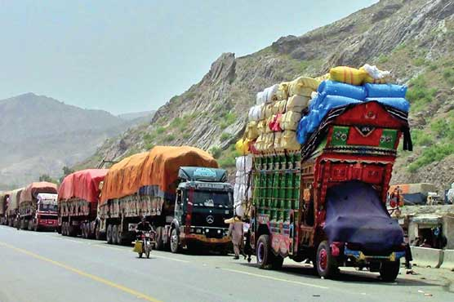
FLEET characteristics
(Results from surveys’ data)

Slide 44
FLEET CHARACTERISTICS
Source: Roadside Interviews Survey

Slide 45
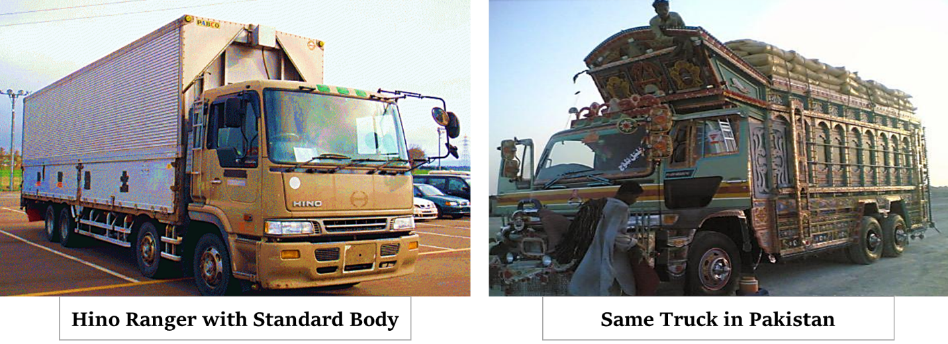
Vehicle modifications
Source: Transport Owners’ Survey

Slide 46
Vehicle modifications (cont.)
Description | Chassis | Engine | Extra Axle Added | Total
2-Axle | 6 | 92 | 53 | 151
3-Axle | 3 | 100 | 52 | 155
4-Axle | - | 47 | 35 | 82
5-Axle | - | 23 | 9 | 32
6-Axle | - | 26 | - | 26
Total = | 9 | 288 | 149 | 446
Source: Roadside Interviews Survey

Slide 47
financial CHARACTERISTICS
Description | Ownership Type
Sole Owner | 1,759
Joint Owner | 680
Driver (self) | 533
Don't know | 240
Commercial Company | 70
Total Responses = | 3,282
Description | Acquisition Mode
Several payments / Instalments | 1,708
Single payment purchase | 693
Loan | 47
Rent | 23
Lease | 3
Don't know | 808
Total Replies = | 3,282
Source: Roadside Interviews Survey

Slide 48
Insurance status
Description | Don't know | None | Insured | % Insured
2-Axle Truck | 220 | 570 | 272 | 25.61%
3-Axle Truck | 178 | 589 | 371 | 32.60%
4-Axle Truck | 74 | 309 | 137 | 26.35%
5-Axle Truck | 41 | 109 | 74 | 33.04%
6-Axle Truck | 54 | 164 | 120 | 35.50%
Total = | 567 | 1,741 | 974 | 29.68%
Source: Roadside Interviews Survey

Slide 49
    Vehicle Purchase and Finance / Capital Investment
Purchase Cost (000’ PKR) of Trucks (Truck Owners’ Survey)
Model | 2-Axle | 3-Axle | 6-Axle
1971 | 2,500 | 3,500 | 4,000
2001 | 3,420 | 5,250 | 7,400
2010 | 4,800 | 5,750 | 8,125
2021 | 5,071 | 6,750 | 11,167
Source: Transport Owners’ Survey

Slide 50
    Major Commodities carried
The major commodities in terms of tons carried by trucks are: 1) general merchandise; 2) ballast, gravel, stone 3) fruit; 4) paddy and rice; and 5) vegetables
Small trucks, that is, 2 & 3-Axle trucks are mostly used for transporting perishable (fruits) goods.
Trailer units are used for the transportation of heavy cargo such as steel, fertilizer, and cement.

Slide 51
    Average Turnaround Time for Major Routes
Route | Distance (Kms) | Average Turnaround Time
Karachi to Lahore | 1260 | 5 days 12 hours
Karachi to Peshawar | 1700 | 7 days
Karachi to Quetta | 690 | 6 days 12 hours
Karachi to Faisalabad | 1110 | 5 days 12 hours
Source: Roadside Interviews Survey

Slide 52
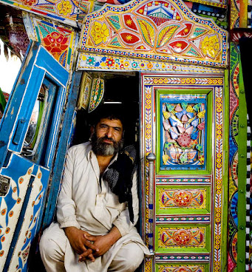
    Driver wages
Average wage of Truck Driver = PKR 16,000/-
Average wage of Driver’s Assistant = PKR 9,350/-
Average Age of Drivers – 36 years old
Drivers return to base – After 18 days on average

Slide 53
    Other findings

Slide 55
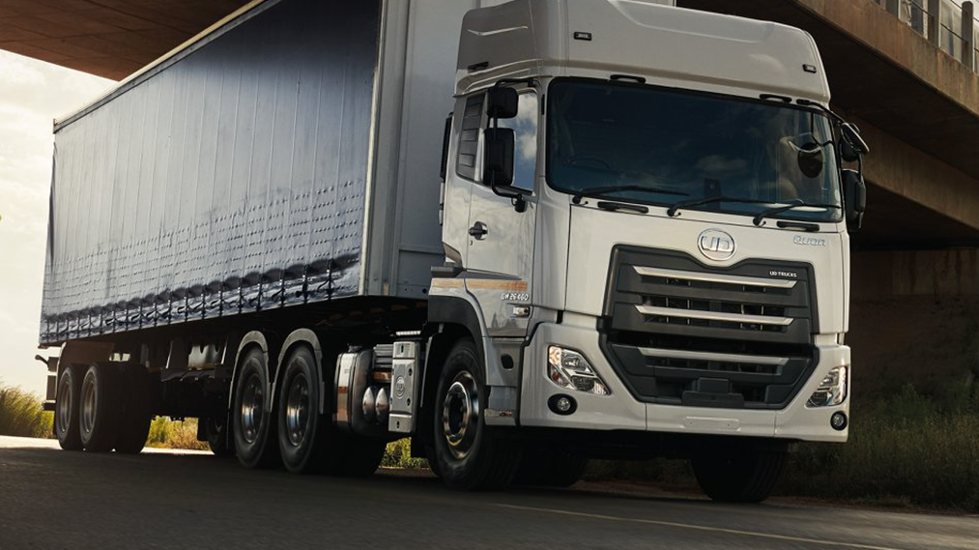
ROAD FREIGHT TRANSPORT PRICES
AND
TRANSPORT COSTS

Slide 56
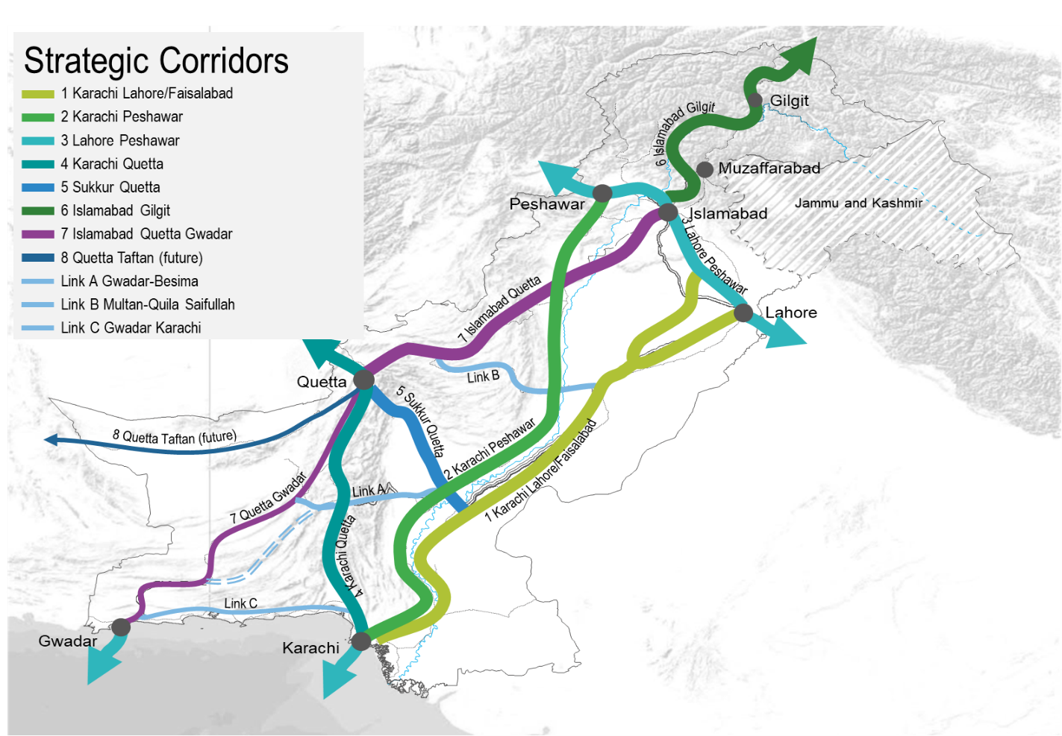
Strategic National Corridors for Road Transport

Slide 57
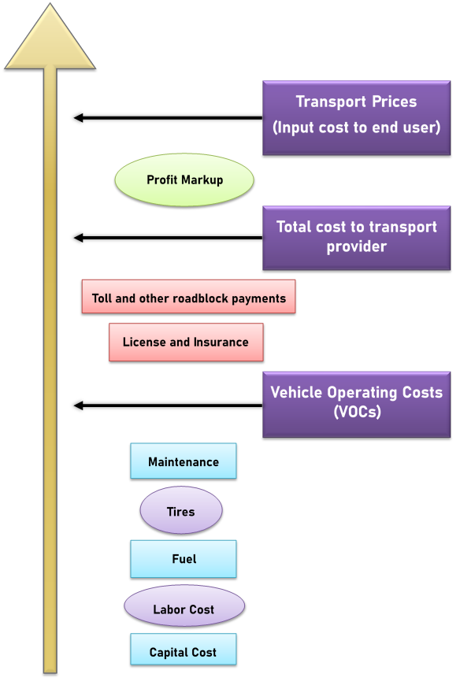
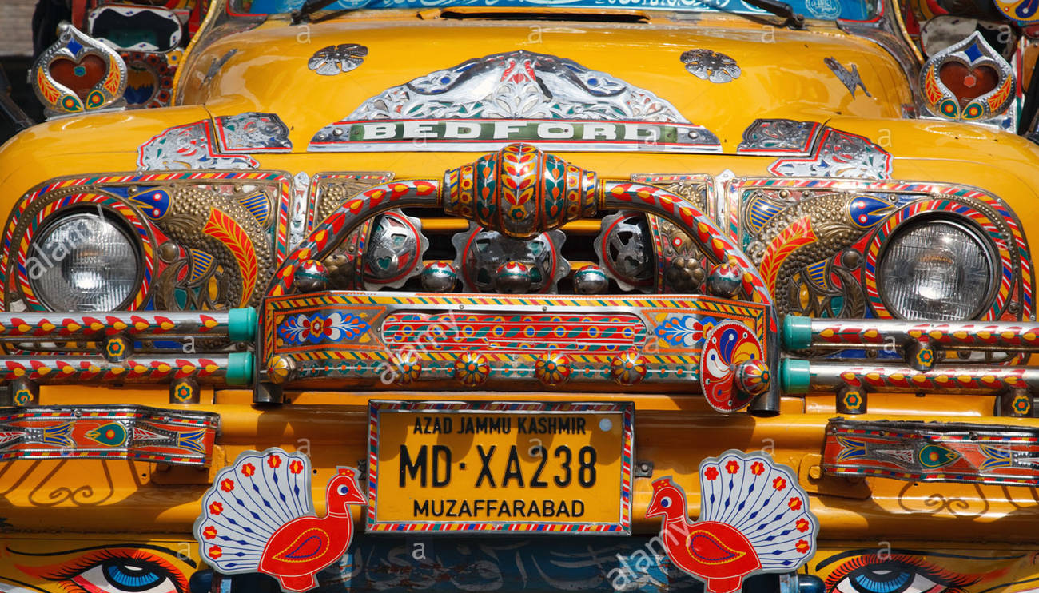
Tier-1
Transport prices – Freight Rates charged by a transport company
Tier-2
Transport costs (TC’s) = VOCs + other indirect costs, such as license, insurance, road toll, and roadblocks payments.
Tier-3

Slide 58
    Road freight transport prices
Source: The World Bank
Transport prices in Pakistan are the lowest.
Prices (per ton-kilometer (tkm)) on the Central African Douala–N’Djame´na route (linking Cameroon with Chad) - more than five times higher than in Pakistan.

Slide 59
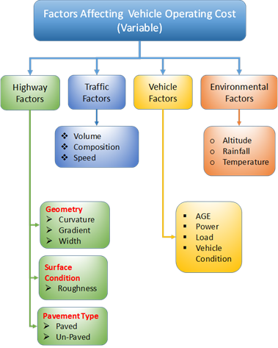
    Road freight transport prices (cont.)
Determination of transport prices or tariffs - tricky estimation
Trucking costs are influenced by many factors such as
    Fuel prices,
    Distance travelled,
    Load capacity of freight vehicle,
    Market characteristics,
    Type of cargo, etc.
Also, subject to demand and are cyclical.
The freight rates for , three categories of truck transport - i,) transportation of petroleum products; ii) transportation of containerized goods; iii) transportation of bulk cargo.

Slide 60
    Road freight transport prices (cont.)
Petroleum Products - Freight Charges for Major Routes in Pakistan (Source: PSO)
S. No | Routes | Distance (Round Trip) / Kms |  |  | Freight / Rs. Per kilolitre
 |  | Plain | Hilly | Total
1 | Karachi - Peshawar | 2,878 | 98 | 2,976 | 8,397
2 | Karachi - Lahore | 2,574 | - | 2,574 | 7,066
3 | Karachi - Faisalabad | 2,352 | - | 2,352 | 6,457
4 | Karachi - Quetta | 914 | 526 | 1,440 | 5,246
*Data as per 29th September 2021
Trucking (Road) freight rates for transportation of petroleum products are based on the round-trip distance (RTD) from the supply source to the destination (delivered location)

Slide 61
    Road freight transport prices (cont.)
Petroleum Products - Freight Rates (Rs/ton-km) for Major Routes in Pakistan
Motorways & National Highways
In ton | 6-wheeler | 10-wheeler | 14-wheeler | 18- wheeler | 18- wheeler | 22- wheeler
 | 2-Axle Rigid | 3-Axle Rigid | 4-Axle (2S2) | 5-Axle (2S3) | 5-Axle (3S2) | 6-Axle (3S3)
Maximum Allowed Load | 17.5 | 27.5 | 39.5 | 49.5 | 49.5 | 58.5
Average Operating Load | 17.5 | 27.5 | 39.5 | 48.5 | 49.5 | 58.5
Average Empty Load | 7 | 12 | 20 | 22 | 21 | 23.5
Average Pay Load | 10.5 | 15.5 | 19.5 | 26.5 | 28.5 | 35
Karachi – Peshawar, One-way Trip Distance 1488 Km
Freight Charge | 61,718 | 91,107 | 114,619 | 155,764 | 167,520 | 205,727
ton-km | 15624 | 23064 | 29016 | 39432 | 42408 | 52080
Tariff in Rs/ ton-km | 3.95 | 3.95 | 3.95 | 3.95 | 3.95 | 3.95
Karachi – Lahore, One-way Trip Distance 1287 Km
Freight Charge | 51,935 | 76,666 | 96,451 | 131,074 | 140,967 | 173,117
ton-km | 13514 | 19949 | 25097 | 34106 | 36680 | 45045
Tariff in Rs/ ton-km | 3.84 | 3.84 | 3.84 | 3.84 | 3.84 | 3.84
Karachi – Faisalabad, One-way Trip Distance 1176 Km
Freight Charge | 47,459 | 70,058 | 88,138 | 119,777 | 128,817 | 158,197
ton-km | 12348 | 18228 | 22932 | 31164 | 33516 | 41160
Tariff in Rs/ ton-km | 3.84 | 3.84 | 3.84 | 3.84 | 3.84 | 3.84
Karachi – Quetta, One-way Trip Distance 800 Km
Freight Charge | 38,565 | 56,930 | 71,622 | 97,332 | 104,678 | 128,552
ton-km | 7560 | 11160 | 14040 | 19080 | 20520 | 25200
Tariff in Rs/ ton-km | 5.10 | 5.10 | 5.10 | 5.10 | 5.10 | 5.10

Slide 62
    Road freight transport prices (cont.)
Containerized Cargo - Freight Rates for 20’ & 40’ Container Transportation by Articulated Trucks (Source: NLC)
Sr. # | Routes | Distance / Kms | 20’ Feet Container Freight in Rs. | 40’ Feet Container Freight in Rs.
1 | Karachi - Peshawar | 1550 | 130,000 | 205,000
2 | Karachi - Lahore | 1205 | 107,500 | 145,000
3 | Karachi – Faisalabad | 1100 | 100,000 | 127,500
4 | Karachi - Quetta | 800 | 92,500 | 125,000
*Data as per 29th October 2021
Freight rates for transportation of containerized products in 20’ and 40’ containers have been fixed by the market forces based on the one-way trip distance from the supply source to the destination (delivered location).

Slide 63
    Road freight transport prices (cont.)
Tariff (Rs/ton-km) of Containerized Products for Major Routes in Pakistan
In ton | 10-wheeler | 14-wheeler | 18- wheeler | 18- wheeler | 22- wheeler
 | (20’) | (40’) | (40’) | (40’) | (40’)
 | 3-Axle Rigid | 4-Axle (2S2) | 5-Axle (2S3) | 5-Axle (3S2) | 6-Axle (3S3)
Maximum Allowed Load | 27.5 | 39.5 | 49.5 | 49.5 | 58.5
Average Operating Load | 27.5 | 39.5 | 49.5 | 49.5 | 58.5
Average Empty Load | 12 | 20 | 22 | 22 | 23.5
Average Pay Load | 15.5 | 19.5 | 26.5 | 28.5 | 35
Karachi – Peshawar, One-way Trip Distance 1550 Km
Freight charge | 130,000 | 163,517 | 222,216 | 238,987 | 293,493
ton-km | 24025 | 30225 | 41075 | 44175 | 54250
Tariff in Rs/ ton-km | 5.41 | 5.41 | 5.41 | 5.41 | 5.41
Karachi – Lahore, One-way Trip Distance 1205 Km
Freight charge | 107,500 | 135,108 | 183,609 | 197,467 | 242,506
ton-km | 18677 | 23497 | 31932 | 34342 | 42175
Tariff in Rs/ ton-km | 5.75 | 5.75 | 5.75 | 5.75 | 5.75
Karachi – Faisalabad, One-way Trip Distance 1100 Km
Freight charge | 100,000 | 125,697 | 170,819 | 183,711 | 225,610
ton-km | 17050 | 21450 | 29150 | 31350 | 38500
Tariff in Rs/ ton-km | 5.86 | 5.86 | 5.86 | 5.86 | 5.86
Karachi – Quetta, One-way Trip Distance 800 Km
Freight charge | 92,500 | 116,376 | 158,152 | 170,088 | 208,880
ton-km | 12400 | 15600 | 21200 | 22800 | 28000
Tariff in Rs/ ton-km | 7.46 | 7.46 | 7.46 | 7.46 | 7.46
Tariff in terms of Rs/ ton-km for transportation of containerized products in the country varies from Rs. 5.41 – 7.46 with lowest on Karachi – Peshawar corridor and highest on Karachi – Quetta corridor.

Slide 64
    Road freight transport prices (cont.)
Bulk Cargo Transportation Tariff
(Source: NTRC Axle Load Survey 2020)
National Highways
In ton | 6-wheeler | 10-wheeler | 14-wheeler | 18-wheeler | 18-wheeler | 22-wheeler
 | 2-Axle | 3-Axle | 4-Axle (2S2) | 5-Axle (2S3) | 5-Axle (3S2) | 6-Axle (3S3)
Maximum Allowed | 17.5 | 27.5 | 39.5 | 48.5 | 49.5 | 58.5
Average Operating Load | 20 | 40.4 | 41.4 | 57.4 | 57.7 | 75
Average Empty Load | 7 | 12 | 20 | 22 | 21 | 23.5
Average Pay Load | 13 | 28.4 | 21.4 | 35.4 | 36.7 | 51.5
In bulk cargo transportation there are no fixed tariff charges, and the customer has to settle it with the goods company or the truck owners who operate independently.
The driver’s dairy data,
Telephonic surveys & Market Analysis
Tariffs in terms of Rs / ton-km

Slide 65
    Road freight transport prices (cont.)
Commodity Wise Tariff (Rs/ton-km);
Route, Karachi - Peshawar
Karachi – Peshawar, One-way Trip Distance 1550 km
Truck Type | 6- wheeler | 10-wheeler | 14-wheeler | 18-wheeler | 18-wheeler | 22-wheeler
 | 2-Axle | 3-Axle | 4-Axle (2S2) | 5-Axle (2S3) | 5-Axle (3S2) | 6-Axle (3S3)
Construction Materials
Freight charge | 67,600 | 147,524 | 111,280 | 184,080 | 190,840 | 267,800
ton-km | 20150 | 44020 | 33170 | 54870 | 56885 | 79825
Tariff in Rs/ ton-km | 3.35 | 3.35 | 3.35 | 3.35 | 3.35 | 3.35
Textile
Freight charge | 65,000 | 141,850 | 107,000 | 177,000 | 183,500 | 257,500
ton-km | 20150 | 44020 | 33170 | 54870 | 56885 | 79825
Tariff in Rs/ ton-km | 3.22 | 3.22 | 3.22 | 3.22 | 3.22 | 3.22
Wheat, Rice, Sugar
Freight charge | 65,000 | 141,850 | 107,000 | 177,000 | 183,500 | 257,500
ton-km | 20150 | 44020 | 33170 | 54870 | 56885 | 79825
Tariff in Rs/ ton-km | 3.22 | 3.22 | 3.22 | 3.22 | 3.22 | 3.22
Fertilizer
Freight charge | 52,000 | 113,480 | 85,600 | 141,600 | 146,800 | 206,000
ton-km | 20150 | 44020 | 33170 | 54870 | 56885 | 79825
Tariff in Rs/ ton-km | 2.58 | 2.58 | 2.58 | 2.58 | 2.58 | 2.58

Slide 66
    Road freight transport prices (cont.)
Commodity Wise Tariff (Rs/ton-km);
Route, Karachi - Lahore
Karachi – Lahore, One-way Trip Distance 1205 km
Truck Type | 6-wheeler | 10- wheeler | 14- wheeler | 18-wheeler | 18- wheeler | 22- wheeler
 | 2-Axle | 3-Axle | 4-Axle (2S2) | 5-Axle (2S3) | 5-Axle (3S2) | 6-Axle (3S3)
Construction Materials
Freight charge | 52,000 | 113,480 | 85,600 | 141,600 | 146,800 | 206,000
ton-km | 15665 | 34222 | 25787 | 42657 | 44223 | 62057
Tariff in Rs/ ton-km | 3.17 | 3.17 | 3.17 | 3.17 | 3.17 | 3.17
Textile
Freight charge | 50,700 | 110,643 | 83,460 | 138,060 | 143,130 | 200,850
ton-km | 15665 | 34222 | 25787 | 42657 | 44223 | 62057
Tariff in Rs/ ton-km | 3.24 | 3.24 | 3.24 | 3.24 | 3.24 | 3.24
Wheat, Rice, Sugar
Freight charge | 52,000 | 113,480 | 85,600 | 141,600 | 146,800 | 206,000
ton-km | 15665 | 34222 | 25787 | 42657 | 44223 | 62057
Tariff in Rs/ ton-km | 3.2 | 3.2 | 3.2 | 3.2 | 3.2 | 3.2
Fertilizer
Freight charge | 52,000 | 113,480 | 85,600 | 141,600 | 146,800 | 206,000
ton-km | 15665 | 34222 | 25787 | 42657 | 44223 | 62057
Tariff in Rs/ ton-km | 3.32 | 3.32 | 3.32 | 3.32 | 3.32 | 3.32

Slide 67
    Road freight transport prices (cont.)
Commodity Wise Tariff (Rs/ton-km);
Route, Karachi - Faisalabad
Karachi – Faisalabad, One-way Trip Distance 1100 km
Truck Type | 6- wheeler | 10- wheeler | 14- wheeler | 18-wheeler | 18- wheeler | 22- wheeler
 | 2-Axle | 3-Axle | 4-Axle (2S2) | 5-Axle (2S3) | 5-Axle (3S2) | 6-Axle (3S3)
Construction Materials
Freight charge | 46,800 | 102,132 | 77,040 | 127,440 | 132,120 | 185,400
ton-km | 14300 | 31240 | 23540 | 38940 | 40370 | 56650
Tariff in Rs/ ton-km | 3.27 | 3.27 | 3.27 | 3.27 | 3.27 | 3.27
Textile
Freight charge | 49,400 | 107,806 | 81,320 | 134,520 | 139,460 | 195,700
ton-km | 14300 | 31240 | 23540 | 38940 | 40370 | 56650
Tariff in Rs/ ton-km | 3.45 | 3.45 | 3.45 | 3.45 | 3.45 | 3.45
Wheat, Rice, Sugar
Freight charge | 48,100 | 104,969 | 79,180 | 130,980 | 135,790 | 190,550
ton-km | 14300 | 31240 | 23540 | 38940 | 40370 | 56650
Tariff in Rs/ ton-km | 3.36 | 3.36 | 3.36 | 3.36 | 3.36 | 3.36
Fertilizer
Freight charge | 50,700 | 110,643 | 83,460 | 138,060 | 143,130 | 200,850
ton-km | 14300 | 31240 | 23540 | 38940 | 40370 | 56650
Tariff in Rs/ ton-km | 3.54 | 3.54 | 3.54 | 3.54 | 3.54 | 3.54

Slide 68
    Road freight transport prices (cont.)
Commodity Wise Tariff (Rs/ton-km);
Route, Karachi - Quetta
Karachi – Quetta, One-way Trip Distance 800 Km
Truck Type | 6- wheeler | 10- wheeler | 14- wheeler | 18-wheeler | 18- wheeler | 22- wheeler
 | 2-Axle | 3-Axle | 4-Axle (2S2) | 5-Axle (2S3) | 5-Axle (3S2) | 6-Axle (3S3)
Construction Materials
Freight charge | 46,800 | 102,132 | 77,040 | 127,440 | 132,120 | 185,400
ton-km | 10400 | 22720 | 17120 | 28320 | 29360 | 41200
Tariff in Rs/ ton-km | 4.5 | 4.5 | 4.5 | 4.5 | 4.5 | 4.5
Textile
Freight charge | 49,400 | 107,806 | 81,320 | 134,520 | 139,460 | 195,700
ton-km | 10400 | 22720 | 17120 | 28320 | 29360 | 41200
Tariff in Rs/ ton-km | 4.75 | 4.75 | 4.75 | 4.75 | 4.75 | 4.75
Wheat, Rice, Sugar
Freight charge | 48,100 | 104,969 | 79,180 | 130,980 | 135,790 | 190,550
ton-km | 10400 | 22720 | 17120 | 28320 | 29360 | 41200
Tariff in Rs/ ton-km | 4.62 | 4.62 | 4.62 | 4.62 | 4.62 | 4.62
Fertilizer
Freight charge | 50,700 | 110,643 | 83,460 | 138,060 | 143,130 | 200,850
ton-km | 10400 | 22720 | 17120 | 28320 | 29360 | 41200
Tariff in Rs/ ton-km | 4.87 | 4.87 | 4.87 | 4.87 | 4.87 | 4.87

Slide 69
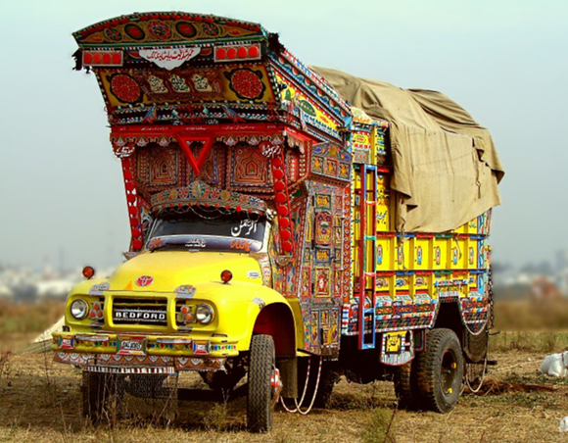
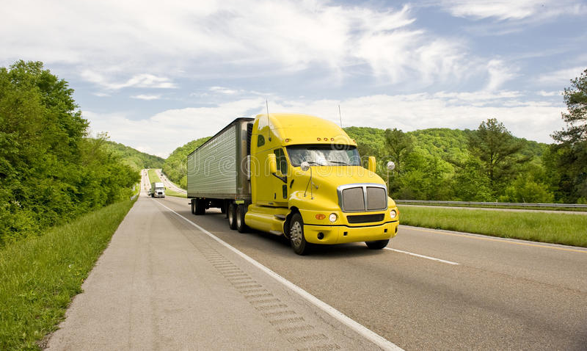
    Road freight transport prices (cont.)
Travel Time is a better indicator of efficiency, compared to Transport Price
Trucks operate long hours in Pakistan
Excessive loads at low speeds in the country, 20 and 25 kph
Average of 80-90 kph in Europe
Journey Time – three times longer than in Europe
Road freight takes 5-7 days between ports and the north of Pakistan (approximately 1,400-1,800 kms), - twice what it takes in Asia and Europe
Trucks’ repairs need due to overloading also extends the transport time
In a globally integrated market, a comparison between Pakistan and developed countries is not out of context as it is with these economies that Pakistan competes internationally.

Slide 70
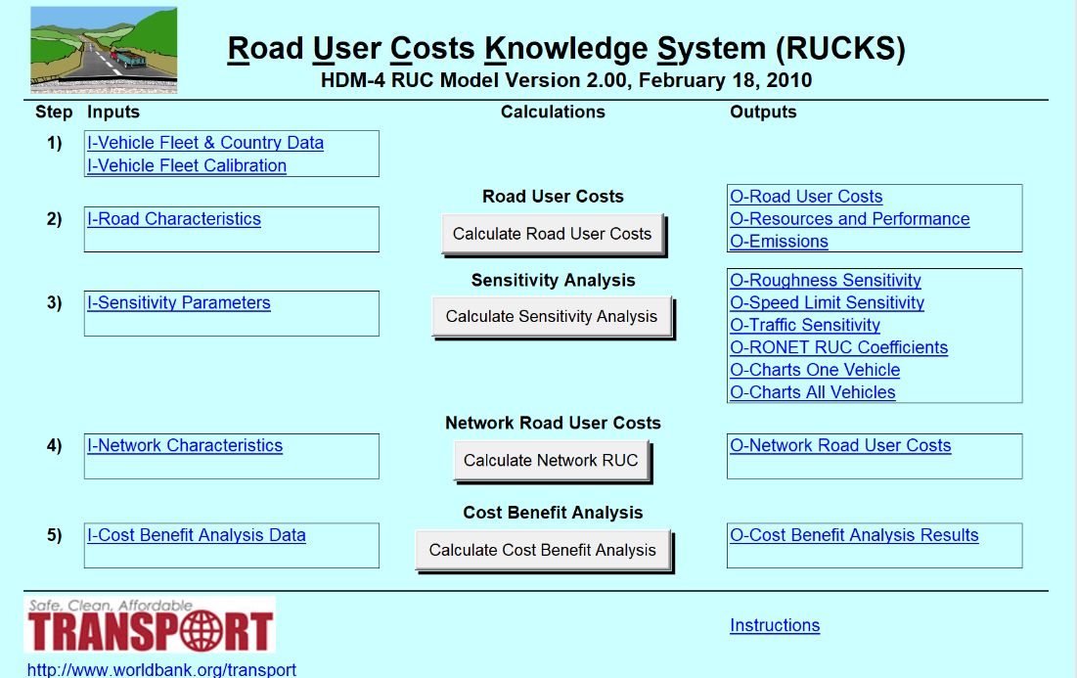
Road Freight Transport Costs
 | Motorcycle | Small Car | Medium Car | Wagon / HiAce | 4-Wheel Drive | light Truck | Medium 2-Axle Truck | Heavy 3-Axle Truck | Articulated Truck | Small Bus | Medium Bus | Large Bus
Vehicle Operating Cost (Rs/1000 vehicle-km) | 7160 | 18881 | 28803 | 51969 | 42934 | 37608 | 70528 | 137206 | 160793 | 61260 | 72298 | 98342
Fuel (Rs/1000 vehicle-km) | 5834 | 11999 | 13855 | 18153 | 14805 | 20346 | 37298 | 85595 | 80632 | 18622 | 26963 | 41803
Lubricant (Rs/1000 vehicle-km) | 209 | 603 | 713 | 1087 | 1016 | 849 | 1165 | 2670 | 2549 | 1236 | 1312 | 1904
Tire (Rs/1000 vehicle-km) | 120 | 432 | 756 | 756 | 1883 | 1452 | 1921 | 3783 | 12716 | 1628 | 2473 | 5246
Maintenance (Rs/1000 vehicle-km) | 109 | 2191 | 6674 | 21852 | 11965 | 5186 | 14166 | 29380 | 45450 | 21955 | 22996 | 29216
Maintenance Labor (Rs/1000 vehicle-km) | 334 | 1302 | 1352 | 1532 | 1124 | 3345 | 6159 | 9533 | 9506 | 5929 | 6139 | 7730
Crew Time (Rs/1000 vehicle-km) | 0 | 0 | 0 | 1340 | 0 | 1212 | 1211 | 1445 | 1605 | 1177 | 1217 | 1639
Depreciation (Rs/1000 vehicle-km) | 555 | 2355 | 5424 | 6765 | 12192 | 4908 | 4799 | 4352 | 7919 | 10058 | 10665 | 10338
Interest (Rs/1000 vehicle-km) | 0 | 0 | 0 | 0 | 0 | 0 | 0 | 0 | 0 | 0 | 0 | 0
Overhead (Rs/1000 vehicle-km) | 0 | 0 | 0 | 484 | 0 | 311 | 581 | 448 | 417 | 654 | 534 | 466

Slide 71
Road Freight Transport Costs
Transport Cost of Trucks by Type in Rs for Route Length Km
Route | Light Truck | Medium 2-Axle Truck | Heavy 3-Axle Truck | Articulated Truck
Karachi - Peshawar ,1550 Km | 58,293 | 109,319 | 212,669 | 249,229
Karachi – Lahore, 1205 Km | 45,318 | 84,986 | 165,333 | 193,756
Karachi – Faisalabad, 1100 Km | 41,369 | 77,581 | 150,927 | 176,872
Karachi – Quetta, 800 | 30,087 | 56,423 | 109,765 | 128,635
Profit in Rs/ trip by Truck Type for Carriage of Construction Materials
Route | Transport Cost (Rs/ trip length) |  | Transport Price (Rs/ trip length) |  |  | Profit in Rs/ trip
 | Heavy | Articulated |  | Heavy | Articulated |  | Heavy | Articulated
 | 3-Axle Truck | Truck 40’ Container |  | 3-Axle Truck | Truck 40’ Container |  | 3-Axle Truck | Truck 40’ Container
 | 20’ Container |  |  | 20’ Container |  |  | 20’ Container
Karachi – Peshawar, 1550 Km | 212,669 | 249,229 |  | 130,000 | 293,493 |  | -82,669 | 44,264
Karachi – Lahore, 1205 Km | 165,333 | 193,756 |  | 107,500 | 242,506 |  | -57,833 | 48,750
Karachi – Faisalabad, 1100 Km | 150,927 | 176,872 |  | 100,000 | 225,610 |  | -50,927 | 48,738
Karachi – Quetta, 800 Km | 109,765 | 128,635 |  | 92,500 | 208,880 |  | -17,265 | 80,245
Three-axle rigid trucks appeared to be in the loss while larger capacity six-axle trucks get very nominal profit. With its low wage levels, Pakistan’s transport costs and prices are much lower—probably the lowest in the world—since the trucking industry is still a labor-intensive activity

Slide 72
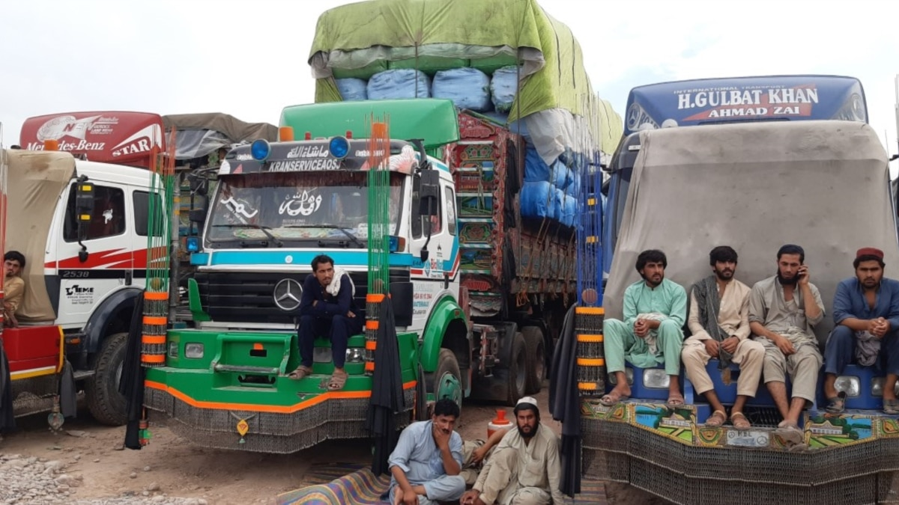
Contemporary Challenges for Local Trucking Industry

Slide 73
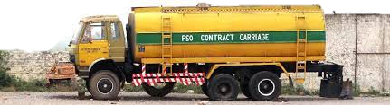
Contemporary Challenges for Local Trucking Industry
Truck Standards
National standards for the manufacturing of rigid trucks do not exist
Roadside retrofitters
Vehicle safety laws on the standards for better braking systems are not present
Technical standards also do not exist for locally manufactured trailers or prime movers
Technical standards for locally manufactured and imported fuel tankers - most comprehensive of any class of trucks
OGRA RT 2009 Standards , based on the ADR (Carriage of Dangerous Goods by Road) standards
The international ADR standards were updated in 2017
The OGRA RT Technical Standards 2009, now require updating to meet the 2017 standard

Slide 74


Contemporary Challenges for Local Trucking Industry (cont.)
Truck Registration
The Pakistan Motor Vehicle Ordinance 1965, mandate the registration, except tractors and tractor-trailers
Standards present for license plates - Non-standardized license plates are common because of weak enforcement of traffic laws
No protocols or processes By EnTDs - to enable inter-provincial data access
Incomplete data recorded for each vehicle and multiple registrations of the same vehicle chassis number
Nature of the problem - Multiple vehicles under generic category of trucks, varying from 2 tons to 60 tons laden weight

Slide 75


Contemporary Challenges for Local Trucking Industry (cont.)
Truck Registration
Motor Vehicle Ordinance, 1965 and Motor Vehicle Rules, 1969 - only two types of drivers' licenses LTV and HTV Driving License
No specific category of driving license for driving trucks is in practice in Pakistan
Developed countries - Commercial Driving License (CDL)
Special endorsements from authorities – for complex configuration involving one or more trailers
Fake driving licenses in Practice

Slide 76


Contemporary Challenges for Local Trucking Industry (cont.)
Safety Standards
The National Highway Safety Ordinance, 2000 (NHSO-2000) - only specific to classifying a freight vehicle if its laden, or Gross Vehicle Weight (GVW) is more than 5,000 kg (about 5 tons).
Inconsistencies - Current freight with a capacity less than 5-ton GVW or exceeding this limit
National Highway Authority (NHA) relaxed allowable limits from 2.5 tons to 8 tons for National Highways.
No relaxation is available on motorways.
Developed countries - specific categories trucks type for regulation purposes; such as special purpose trucks

Slide 77

Contemporary Challenges for Local Trucking Industry (cont.)
Truck Registration
Vehicle Licensing Regime
Vehicle licensing system - essential component of a road transport safety management system
Licensing systems provide a legal connection between the vehicle owner and the vehicle
Enables the implementation of road safety measures
Vehicle registration systems harmonization - Documentation, and procedures to ensure minimum safety standards and enhance enforcement of these standards
Motor Vehicle Rules of 1969 made under the Motor Vehicle Ordinance 1965
Section 3, Federal Excise Act of 2005, requires that all motor vehicles (except tractors, and trailer units of the articulated trucks and tractor-trailers) with an engine capacity above 50cc must be registered
The process for vehicle licensing consists of:
Proof of compliance with applicable technical standards:
Registration
Insurance

Slide 78
Contemporary Challenges for Local Trucking Industry (cont.)
Truck Registration
Motor Vehicle Fitness Certification
Chapter 6 of the Motor Vehicle Rules (MVR) of 1969 made under the Motor Vehicle Ordinance 1965, established motor Vehicle Fitness Certification Offices (MVFCO)
MVFCO offices are responsible for periodic inspection of public service vehicles
Periodic fitness inspections include inspection of brakes, lights, suspension, reversing, horns, silencers, mirrors, dangerous projections, noise, safety glass, wipers, tires, emissions, speedometer, overall dimensions, turning radius, and seating
Punjab has recently introduced a Vehicle Inspection and Certification System (VICS)
Ongoing inspections are required every 6 months to obtain a fitness certificate for license renewal.

Slide 79

Contemporary Challenges for Local Trucking Industry (cont.)
Truck Registration
Ease of Doing Business
Source: World Bank Report Doing Business 2020

Slide 80


Contemporary Challenges for Local Trucking Industry (cont.)
  Carriage of Dangerous Goods (ADR)
ADR Regulations, 2009 - International standards for the regulation of the carriage of dangerous goods by road
In Pakistan, regulations governing vehicles transporting petroleum products must comply with standards under OGRA
Road Transport 2009 does not meet (but are based on) ADR 2009
Pakistan requires increased regulation to address standards required for the transport of all dangerous goods
It is also recommended that part-built truck and chassis units be prohibited from being issued a vehicle license
ADR legislation implementation - to ensure the safe transport of dangerous goods
National legislation

Slide 81


Contemporary Challenges for Local Trucking Industry (cont.)
  New Road Safety Legislation
New road safety legislation are needed.
Introduction of post-crash response standards.
National Road Safety Action Plan 2020-2024 - provincial governments are stakeholders.
Harmonization: with the increase in motorized road traffic in Pakistan there is a need to achieve harmonization on a number of issues. Include: driver licensing, vehicle registration, examination and law enforcement, and insurance of motor vehicle third party risks.
Local autonomy: constitutional reform (the 18th amendment to the Constitution) has devolved the power of administration of roads and road traffic.
Road Safety Goals: Major issues related to road safety which should be addressed and determined by the legislative arm of government (the Parliament), leaving implementation issues to the executive (the relevant agencies with accountability to a Minister).

Slide 82

Industrial Classification Schedule (ICS), - two broad categories: (i) commodity producing sectors and (ii) service sectors
Commodity-producing sectors - (a) primary sector and (b) secondary sector
Service sector - tertiary sector
Employment in Transport, Storage, and Communication is one of the 6 subsectors of the tertiary sector.
Leading sector of employment in Pakistan (2015) - Tertiary/service sector (42.1 percent)
In 2020-21, the sales and service workforce equal to 16.10 percent of the total labor force in the service sector.
Estimate the number of persons employed in the trucking sector - assumed rate of about 40 employees per truck on the road
Presently - about 350,000 trucks are registered, or on-road, the number of persons employed, approx. 14 million.
Projected truck population of 400,000 – 16 Million, the number of employment in Transport Sector
  Employment Generation by Trucking Industry

Slide 83

MODERN TRUCKING CONCEPTS

Slide 84


Modern Trucking Concepts
Key elements of the best practices in the road freight transport sector
Clean and Low Carbon Fuels
Advanced Technologies,
Operations and Management
Improvement in Infrastructure
Policies and Institutional arrangements
Better truck technologies - improvements in increase fuel efficiency,
Information Technology
Truck shapes to reduce aerodynamic drag,
Vehicle Management System
Reduction in truck weight, Alternative fuels and engine technologies.
Source: Roadside Interviews Survey

Slide 85


Modern Trucking Concepts (cont.)
Aerodynamic Drag Reduction
State-of-the-art aerodynamics ensure vehicle control, fuel efficiency and emission control

Slide 86



Modern Trucking Concepts (cont.)
Advanced Trucking Manufacturing Technologies
    Automatic Tires Inflation Systems
    Vehicle Profile Improvement II
    Closing and Covering of Gap between Cabin and Trailer
Vehicle Profile Improvement I
Cabin Top Deflector, Sloping Hood, and Cabin Side Flares

Slide 87


Modern Trucking Concepts (cont.)
Pneumatic Aerodynamic Drag Reduction
Reduction in vehicle fuel energy requirements
This system reduces energy use for an individual truck by 3.9% to 4.8%
Suitable for combination trucks that have van trailers

Slide 88


Modern Trucking Concepts (cont.)
Weight and Accessory Load Reduction
Reducing the truck weight can be very effective
Fuel savings of 3.5% to 4% for a 10% weight reduction in trucks. Other studies have found that a
Research - 4% reduction of weight by lightweight material substitution could offer energy savings of up to 4%.

Slide 89


Modern Trucking Concepts (cont.)
Advanced Transmission
Improvement in engine technology to reduce fuel consumption and exhaust emissions

Slide 90



Modern Trucking Concepts (cont.)
Hybrid Trucks
Medium-duty trucks in local service (e.g., delivery) can reduce energy use by 41.5%.

Slide 91

Modern Trucking Concepts (cont.)
Aerodynamic Drag Reduction
Proper maintenance and fitness certification

Slide 92


Modern Trucking Concepts (cont.)
 | In Use |  | Currently under Planning & Development |  | No Plan to Use
Tools | n | % | n | % | n | %
Internet (such as company’s website etc.) | 44 | 51.8 | 19 | 22.4 | 22 | 25.9
Electronic fund transfer (such as online bank transactions, Easy Paisa etc.) | 73 | 85.9 | 10 | 11.8 | 2 | 2.4
E-mail | 54 | 63.5 | 9 | 10.6 | 22 | 25.9
Vehicle tracking system | 44 | 51.8 | 16 | 18.8 | 25 | 29.4
Bar-coding | 6 | 7.1 | 11 | 12.9 | 68 | 80.0
Intranet | 17 | 20.0 | 8 | 9.4 | 60 | 70.6
Enterprise resource planning, ERP (such as account management, warehouse management etc.) | 15 | 17.6 | 16 | 18.8 | 54 | 63.5
Digital marketing | 4 | 4.7 | 14 | 16.5 | 67 | 78.8
Fleet Management System
Optimize transportation time
Optimize transportation cost and fuel consumption
Optimize fleet and resources utilization
Reduces emissions
Source: Transport Operators Survey

Slide 93

Modern Trucking Concepts (cont.)

Slide 94




Modern Trucking Concepts (cont.)
Best Practice: Truck Scrappage Scheme
Trucks are a relatively high contributor to transport emissions
Older trucks are a high contributor to air pollution.
China has introduced fuel economy standards for cars and trucks
vehicle emission and fuel quality standards
“yellow label” scheme that bans polluting trucks from city centers and
China aims to have yellow label trucks removed from the fleet all together

Slide 95

SWOT ANALYSIS
Strengths
Weaknesses
Opportunities
Threats
Door-to-door service
Cheaper Labor
Preferred method of transportation
Most Economical
Accessible to everywhere
Most Reliable
Direct employment
Far-flung areas
Informal service providers
Outdated Fleet
Non-availability of normal working lifters
Overloading due Low freight rates
Prevalence of pressure groups
Safety issues
No access to formal finance
No barrier to entry and exits
High transportation demand
Resumption CPEC related activities and increase in Large Scale Manufacturing (LSM) Adaption of Information Technology (IT)
Expected Increase in Freight transport due to development of Motorway network
CPEC: Modernized fleet
Development of ML-1 under CPEC will provide an alternative for freight and transport
Exchange Rate volatility
Current economic conditions
Increasing of tax and fuel prices are bigger threats to freight Industry
Tariffs on truck imports

Slide 96

  Conclusion
Informal Sector
Fragmentation
Overloading – A major Issue
Freight Rates & Low Profits
Police Bribes and Driver’s problems
Insurance System – Not satisfactory
Lack of formal finance
National Standards, Legislation and Laws
Axle Load Limit - Trucking Association & Industry Stance

Slide 97

RECOMMENDATIONS

Slide 98

New and Emerging Challenges of the Trucking Sector
Challenges | Enablers and Facilitation
Long term planning of the sector with clear institutional responsibilities | Designation of the lead agency in the government, improved statistics on trucks and road freight movement trends
Create and expand domestic demand for heavy freight vehicles | Appropriate tariffs, improved product quality, improved affordability of consumers
Encourage manufacturing and export of heavy commercial vehicles | The paradigm shift from assembling to manufacturing, competitive prices for entry to the new market
Rationalize fiscal and monetary measures for the promotion of the truck freight transport sector | Reduced GST rates and minimum taxes on the export of the vehicles.
Remove sector externalities and inefficiencies and encourage fleet modernization | Promote vehicles safety and performance standards, limit the import of second hand and under-performing vehicles
Attract investments in all modes of land freight transport | Encourage investments in railways to reduce the burden on the road freight transport
Improve efficiency and environmental performance of road freight vehicles within the country and across the region | Develop and implement fuel improvement program in the country, enhanced vehicle emission standards
Extend credit facilities and financial services at concessional rates to the road freight transport sector | Encourage fresh entry into the sector and promotion of employment opportunities, multiplier effects on the economy
Ensure long term stability of the government policies in the sector | The time horizon of the policy should be 3-5 years with normal annual reviews
Improved and effective coordination at all levels in the government for efficient operations of the road freight transport | Functions falling outside the jurisdiction of the federal government should be financially supported for the policy to be successful

Slide 99

Guidance in Policy Areas to Improve Urban Distribution
Policy Area | Guidance
Improve management System | - Identify clear functions between competent authorities in urban distribution at both national and local levels.
 | - Establish coordination mechanisms at local levels, with local government taking the lead.
Plan well | - The urban distribution development plan should be developed by the city planning authority in association with the authorities involved in urban distribution management.
 | - The urban distribution development plan should be incorporated into overall city planning, and linked with other relevant plans such as land, commerce, transport, logistics, and express mail.
Enhance infrastructure | - Build infrastructure for urban distribution channels and terminals.
 | - Improve parking and loading and unloading facilities.
 | - Issue rules and standards for conducting a transport impact assessment of urban distribution, and make transport impact assessment of urban distribution obligatory for any new, renovation, or extension projects of urban roads, commercial areas, residential areas, and large public areas when applying for approval at the planning stage.
Strengthen the management of the transport market | - Promote the standardization of trucks for urban distribution.
 | - Regulate the behaviors of companies leasing trucks for doing the urban distribution.
 | - Establish trust review systems for urban distribution enterprises.
Optimize movement control measures | - Use a permit system to control access of trucks to congested urban roads at peak periods.
 | - Provide more parking areas for urban distribution trucks.
Strengthen enforcement | - Eliminate existing unnecessary or illegal charges throughout the entire logistics process.
 | - Supervise urban distribution prices to direct reasonable market Pricing.
 | - Impose a punishment for violations.
 | - Ensure safety of logistics enterprises.
Accelerate promotion and application of science and technology | - Encourage and guide logistics enterprises to integrate resources for cost reduction and efficiency improvement through centralized storage and warehouse management, demand-based distribution, and planned delivery.
 | - Encourage the application of advanced technologies and equipment for urban distribution
 | - Accelerate the construction of an urban distribution of information platform.
Speed up implementation | - Local government should take the lead in organizing the urban distribution development.
 | - Implement pilot projects.
 | - Monitor performance of competent authorities through.

Slide 100

  Best Practices linkage to the context of Pakistan
Vehicle Phase-Out Program
Freight fleet in Pakistan - old and technologically outdated
Fuel inefficient and extremely environmentally unfriendly
Vehicle phase-out scheme with financial support from the government
Volunteer program for initial five years - and then mandatory
Trucks to be scrapped if they meet one or more of the following four conditions as practiced in China:
        Limits of service years reached from the date the vehicle is registered;
              Failure to meet the national standard of vehicle safety, technical requirements for in-use vehicles;
              Failure to meet national standards of air pollution emissions or noise prevention for in-use vehicles; and,
    Fail three times consecutively at vehicle inspection.
Recommended scrappage – certain limit for truck kilometers traveled

Slide 101
  Best Practices linkage to the context of Pakistan (cont.)
Vehicle Phase-Out Program
Limits of Vehicle Compulsory and Recommended Scrappage in China
Types of Vehicles | Compulsory Scrappage |  | Recommended Scrappage
 | Service Life (Year) | Travel Distance (10,000 Km) | Travel Distance (10,000 Km)
Mini trucks | 12 | 50 | 50
Light-duty trucks | 15 | 60 | 60
Heavy-duty trucks | 15 | 70 | 70
Trucks for Transportation of Dangerous Goods | 10 | 40 | 40
Three-wheeled low-speed trucks loaded with a single cylinder engine | 9 | NA | NA
Low-speed trucks loaded with a multi-cylinder engine | 12 | 30 | 30
Trucks for special uses | 15 | 50 | 50
Source: CA-Asia and WB

Slide 102

  Recommendations
Institutional changes – as rent-seeking behavior and governance are at the core of the issues faced by the trucking industry in the country.
Modernization of trucking fleet
Wider network of regulatory controls under the Federal Ministry of Government of Pakistan
Axle load regime must be enforced in letter and spirit
Weigh stations should be strategically located near the load generating centers
Promote Containerized cargo - helps control overloading
Establishment of inland freight stations - ensure greater availability of containers

Slide 103
  Recommendations
Stricter enforcement of truck safety, mechanical and environmental regulations
National design standards
Relaxation of import restrictions on used trucks (after proper testing)
Abolition of most of the road-checks
Ban on the current practice of registering and licensing a truck chassis – Licensing on manufacturer's compliance certificate or vehicle PIN
Necessary legislation for trailer manufacturing and registration
Routine inspection/maintenance (I/M) and Special trainings

Slide 104
  Recommendations
Vehicle body improvement / Weight reduction
Motor vehicle examination
Compulsory Truck scrappage
Driver training / Education, eco-friendly driving and equipment handling training
Improved wages for workers
Encouraging alternative modes

Slide 105
Thank You!

